Slide 1
INTERNAL ONLY
BUILD THE STORY
How to Use This Pick Deck
01
Start with buyer + catalyst
02
Follow the narrative spine
This deck is a library, not a linear presentation. Build a client-ready story by selecting only the slides that match the buyer, catalyst, lifecycle moment, and desired depth.
03
Choose only relevant depth
04
End with proof + next step
INTERNAL ONLY — Remove this slide and any internal section guides before sharing externally.
© 2026 West Monroe Partners | Reproduction and/or distribution without West Monroe Partners’ prior consent is prohibited.
Notes:
Source deck: Software Modernization Walking Deck_04132026.pptx.
Insert source slides 9 through 11, 13 through 14, and 15 through 31 unchanged after this divider.
Omit source slide 12 because it is the old contact call to action.
Preserve source order, formatting, metrics, client descriptors, caveats, and notes.
The source is internal and verify-before-external-reuse.
Some outcomes may be modeled or identified rather than realized, and notes may contain names not visible on slides.
Transition: After a selected proof example, bring the audience back to one specific account action.

Slide 2
INTERNAL PICK-DECK GUIDE
IN THIS SECTION
Modernization Economics in the AI Age
01
Economics shift
02
Business value unlocked
Set the stage by showing why modernization has historically been difficult, how AI changes the work, and what new choices that creates.
03
Use cases + catalysts
04
Ecosystem example
Recommended use: select 3–6 slides based on the buyer's urgency and familiarity with modernization.
© 2026 West Monroe Partners | Reproduction and/or distribution without West Monroe Partners’ prior consent is prohibited.
Notes:
Source deck: Software Modernization Walking Deck_04132026.pptx.
Insert source slides 9 through 11, 13 through 14, and 15 through 31 unchanged after this divider.
Omit source slide 12 because it is the old contact call to action.
Preserve source order, formatting, metrics, client descriptors, caveats, and notes.
The source is internal and verify-before-external-reuse.
Some outcomes may be modeled or identified rather than realized, and notes may contain names not visible on slides.
Transition: After a selected proof example, bring the audience back to one specific account action.

Slide 3

MODERNIZATION ECONOMICS
The script has flipped on application modernization
AI is significantly reducing the time and cost of complex modernization by changing how teams analyze, design, build, test, and transition systems.
How are your legacy systems holding your business back?
If modernizing your legacy software cost one-tenth of what you expect, what would that unlock for your business?
AI-NATIVE READINESS
GROWTH VELOCITY
COST EFFICIENCY
CUSTOMER MOAT
How can you make your business ready to become an AI-native enterprise?
What products could you launch—or which markets could you enter—without legacy release-cycle delays?
Where would streamlined integrations and fewer handoffs unlock efficiencies across your business?
How could you strengthen your customer moat by giving them a more integrated experience?
Notes:
SPEAKER BEATS
The historical choice often looked poor in every direction: continue carrying legacy risk, reorganize the business around a packaged platform, or accept a large custom rebuild.
Paint a future the business wants. Modernization can unify an acquired platform, unlock a market, redesign a consequential process, or create the foundation for agent-enabled work.
“One-tenth of what you expect” is a conditional thought experiment. It invites the audience to reconsider deferred opportunities; it is not a claim that every program now costs one-tenth as much.
The strategic claim is expanded choice. Business-fit modernization can deserve consideration more often.
TRANSITION
The first consequence of changed economics is strategic choice. The business no longer has to assume that its only practical future is to preserve legacy systems or conform to a broad packaged platform.
EVIDENCE / GUARDRAIL
Treat “the script has flipped” as the campaign thesis. Slide 1A explains the strategic implication, and slide 2 shows the workstreams and cases behind it. Do not attach a universal percentage or claim that every modernization is now inexpensive.

Slide 4
AI is lowering modernization costs – and shifting the traditional equation on buy vs build decision-making.
Planning, implementation, and legacy maintenance are all getting cheaper, making strategic fit—not technical feasibility—the defining choice.
BUY
BUILD
MODERNIZATION ECONOMICS
Accelerate standard capabilities
Own differentiated capabilities
AI lowers cost at every stage of the modernization journey
BEST WHEN
BEST WHEN
PLAN & UNDERSTAND
Needs are common across the market
Time-to-value outweighs customization
Workflows create competitive advantage
Control of data, experience and roadmap matters
Faster discovery, mapping and requirements
TRADE-OFFS
TRADE-OFFS
IMPLEMENT & BUILD
Fit gaps can force process compromise
Licensing and vendor roadmaps constrain change
Requires durable product and engineering capability
Ownership includes ongoing maintenance
Accelerate coding, testing and migration
MAINTAIN LEGACY
Reduce run cost and reliance on scarce legacy skills
As AI lowers planning, build and legacy run costs, choose buy versus build based on strategic fit, differentiation and ownership.
Notes:
CORE MESSAGE
The business is no longer forced to reshape itself around a single software model. Organizations can make a more informed capability-by-capability choice about where off-the-shelf enterprise software should lead and where technology should be built around the business.
OFF-THE-SHELF ENTERPRISE SOFTWARE
Large enterprise platforms such as CRM and ERP bring the expertise of a product company that may spend years refining workflows, data models and operating patterns for a function or industry.
The buyer benefits from that outside expertise and avoids building the core product. The tradeoff is that the platform normally must be configured, trimmed, integrated and tailored—and the organization often adapts its people, language, processes and data to the technology selected.
BUSINESS-FIT CUSTOM SOFTWARE
A business-fit solution starts with the expertise inside the organization: the processes, practices, controls, customer experience and ways of working that have proved effective for that business.
Technology can be designed around the organization’s people and process rather than requiring the organization to adopt a vendor’s model. This does not mean preserving every current process; modernization should still improve work that creates friction or limits performance.
WHY REVISIT THE DECISION
Earlier buy-versus-build decisions were made when custom modernization required more time, specialized labor and cost. If AI-assisted analysis, prototyping, engineering, testing and maintenance materially reduce those costs, the economic threshold for a business-fit build changes.
For CRM, ERP and other large enterprise capabilities, re-evaluate prior assumptions using current implementation cost, speed to value, organizational-change burden, lifecycle operations, risk and strategic value. Do not assume that yesterday’s answer remains the right answer.
EVIDENCE POSTURE
The message is expanded buyer choice—not the demise of SaaS and not a universal preference for custom development. Off-the-shelf software remains compelling where vendor expertise, ecosystem scale, regulatory standards or common processes create value. Lower custom-build cost and lower change burden remain hypotheses to validate for each client and capability.
TRANSITION
The strategic choice becomes credible only if the underlying modernization work can now be performed at a different cost, speed and quality. The next section should demonstrate that evidence.

Slide 5
@Rachel is going to wordsmith/expand
Lower-cost custom software scales what makes you unique—while minimizing workflow, role and vocabulary disruption
Unlike off-the-shelf platforms, a bespoke build can preserve the processes and language that work—while changing only what modernization needs to improve.
WHY BUILD
ADVANTAGE 01 | OPERATIONAL DIFFERENTIATION
Make software conform to the business—not the reverse
Scale what makes the business unique
Turn distinctive processes and capabilities into repeatable, software-enabled operations.
01 UNIQUE PROCESSES
CHANGE
ON YOUR TERMS
Encode the workflows, controls and decisions that make the business distinct.
02 FAMILIAR LANGUAGE
ADVANTAGE 02 | LOWER CHANGE IMPACT
Retain the vocabulary people use to understand and run the business.
Modernize without forcing wholesale reinvention
Less process translation • Less vocabulary shift
Focused retraining
03 SELECTIVE MODERNIZATION
Preserve familiar processes, roles and vocabulary where they still create value.
Change selectively; preserve proven ways of working.
BUILD WHEN: Differentiation matters and you want to choose deliberately where the business changes—and where the software adapts.
Notes:
CORE MESSAGE
The business is no longer forced to reshape itself around a single software model. Organizations can make a more informed capability-by-capability choice about where off-the-shelf enterprise software should lead and where technology should be built around the business.
OFF-THE-SHELF ENTERPRISE SOFTWARE
Large enterprise platforms such as CRM and ERP bring the expertise of a product company that may spend years refining workflows, data models and operating patterns for a function or industry.
The buyer benefits from that outside expertise and avoids building the core product. The tradeoff is that the platform normally must be configured, trimmed, integrated and tailored—and the organization often adapts its people, language, processes and data to the technology selected.
BUSINESS-FIT CUSTOM SOFTWARE
A business-fit solution starts with the expertise inside the organization: the processes, practices, controls, customer experience and ways of working that have proved effective for that business.
Technology can be designed around the organization’s people and process rather than requiring the organization to adopt a vendor’s model. This does not mean preserving every current process; modernization should still improve work that creates friction or limits performance.
WHY REVISIT THE DECISION
Earlier buy-versus-build decisions were made when custom modernization required more time, specialized labor and cost. If AI-assisted analysis, prototyping, engineering, testing and maintenance materially reduce those costs, the economic threshold for a business-fit build changes.
For CRM, ERP and other large enterprise capabilities, re-evaluate prior assumptions using current implementation cost, speed to value, organizational-change burden, lifecycle operations, risk and strategic value. Do not assume that yesterday’s answer remains the right answer.
EVIDENCE POSTURE
The message is expanded buyer choice—not the demise of SaaS and not a universal preference for custom development. Off-the-shelf software remains compelling where vendor expertise, ecosystem scale, regulatory standards or common processes create value. Lower custom-build cost and lower change burden remain hypotheses to validate for each client and capability.
TRANSITION
The strategic choice becomes credible only if the underlying modernization work can now be performed at a different cost, speed and quality. The next section should demonstrate that evidence.

Slide 6
WEST MONROE MODERNIZATION IMPACT
West Monroe modernization programs accelerate delivery, protect continuity, and lower operating effort
Three client stories show how focused modernization converts technical execution into measurable business outcomes.
01
CUSTOMER APPLICATION REWRITE
02
INTERCONNECTION PLATFORM
03
COMPLIANCE REPORTING PLATFORM
Healthcare professional association
Large investor-owned utility
HR compliance software provider
A critical customer-facing application was assessed and rewritten in less than half the traditional timeline.
A mission-critical interconnection platform was modernized across six operating companies without disrupting service.
A legacy compliance platform was redesigned to deliver customer reports faster and at lower operating cost.
12 → 5
58%
6
~700K
65%
$30K
MONTHS
FASTER DELIVERY
OPERATING COS.
LINES MODERNIZED
FASTER REPORTS
AVG. SAVINGS / CLIENT
BUSINESS VALUE
BUSINESS VALUE
BUSINESS VALUE
Strengthened security and restored a maintainable delivery path while reducing deadline and release risk.
Protected critical workflows, reduced cutover risk, and created a scalable foundation for future interconnection demand.
Reduced consultant effort, accelerated customer reporting, and established a scalable cloud platform for growth.
Illustrative West Monroe client outcomes; the 12-month comparison baseline is directional and should be validated before external use.
© 2026 West Monroe Partners | Reproduction and/or distribution without West Monroe Partners’ prior consent is prohibited.
4
Notes:
SPEAKER BEATS
The technical measures matter only when they connect to a business outcome. These sources support three value pools: meeting an urgent deadline, protecting continuity during a high-scale transition, and lowering recurring operating effort.
ACCELERATE DELIVERY — HEALTHCARE PROFESSIONAL ASSOCIATION
A critical customer-facing application faced an urgent AngularJS end-of-life deadline. West Monroe assessed and rewrote the application within five months, strengthened security, and created repeatable patterns for future enhancements. The business value is deadline certainty and a maintainable base for continued change. The source does not provide project cost, a before-AI duration, or evidence that AI caused the five-month result.
PROTECT CONTINUITY — LARGE INVESTOR-OWNED UTILITY
The client needed to modernize a decade-old solar interconnection solution supporting workflows across six operating companies. The program migrated more than 675,000 lines of code and modified more than 800 files. Business stakeholders validated feature parity, and the old and new interfaces ran side by side in production before final cutover. The value is protection of critical operations, improved maintainability and development efficiency, and reduced transition risk. The source does not report duration, program cost, cost savings, or a before-AI baseline.
LOWER OPERATING EFFORT — HR COMPLIANCE SOFTWARE PROVIDER
The legacy on-premise platform had lengthy report-processing times, limited third-party integration, duplicated functionality, complex workflows, and security vulnerabilities. The redesigned cloud platform used AI/ML-enabled automation to simplify highly manual tasks. The reported result was a 65% reduction in total report-generation duration and more than $30,000 in average savings per customer based on consultant time saved. This is the strongest quantified business-value proof on the slide.
EVIDENCE DISCIPLINE
Do not imply a before-versus-after AI comparison that the sources do not contain. The source material does not provide the cost or timeline of a traditional non-AI alternative. The first two cases demonstrate modernization value pools, not isolated AI causality. Revalidate every metric immediately before release.
Transition: The next slide should make the historical sources of modernization cost, delay, and risk explicit, then show where AI can plausibly change the work with appropriate engineering and governance controls.
Working sources: West Monroe software modernization examples slide 9; large investor-owned utility client story slide 15; HR compliance software provider client story slide 25.

Slide 7
Three Points with Data/Metrics Callout
Placeholder subhead
Placeholder copy here
…
…
…
Placeholder copy here
…
…
…
Placeholder copy here
…
…
…
Topic 1
Topic 2
Topic 3
CALLOUT HEADLINE
XX%
XX
XX
XXXX
XX
XX
data point
data point
data point
data point
data point
data point
*enter sources here
See more results at westmonroe.com/clientstories

Slide 8
Why complex modernization has historically been slow and expensive
Coding is only one part. The harder work is rediscovering how the business runs, deciding what should change, aligning operators and technical teams, cleaning and migrating data, validating the target, and executing a safe cutover.
DISCOVER AND DEFINE
DELIVER AND TRANSITION
01
RECONSTRUCT BUSINESS BEHAVIOR
04
UNTANGLE DEPENDENCIES AND CLEAN DATA
Document current processes, rules, exceptions, and workarounds—and the business outcomes and controls they support.
Map integrations and shared data, then resolve dirty, duplicate, incomplete, and inconsistent records before migration.
02
DECIDE WHAT TO RETAIN OR REIMAGINE
05
VALIDATE DURING PARTIAL CUTOVER
Separate essential processes and controls from obsolete features, defects, duplication, and workarounds.
Run UAT while legacy and modern modules coexist, reconciling results and validating end-to-end behavior across both environments.
03
ALIGN BUSINESS AND TECHNICAL TEAMS
06
EXECUTE A SAFE CUTOVER
Translate operator intent into shared process designs, requirements, architecture, tests, training, and operating procedures.
Sequence data and user migration, manage rollback and controls, and protect ongoing operations through the transition.
© 2026 West Monroe Partners | Reproduction and/or distribution without West Monroe Partners’ prior consent is prohibited.
6
Notes:
Poor documentation and concentrated expertise make discovery slow.
Context can disappear when business intent moves into process designs, technical requirements, tests, training, and operating procedures.
Hidden dependencies cause late rework.
Validation and transition remain expensive because the business must continue operating while the system changes.
These challenges affect custom rebuilds, packaged platform changes, replatforming, and portfolio consolidation in different proportions.
Lower-cost analysis, building, and validation make a wider set of business outcomes economically credible.

Slide 9
What modernization can unlock for the business
POSSIBLE VALUE DIRECTIONS
Modernization can change how the business grows, operates, and serves people.
01
GROWTH
02
OPERATING PERFORMANCE
03
CUSTOMER AND EMPLOYEE EXPERIENCE
New markets, products, channels, and acquired customers
Less manual work, fewer errors, shorter cycles
Connected journeys, self-service, faster decisions
04
RISK AND RESILIENCE
05
STRATEGIC FLEXIBILITY
06
LONG-TERM ECONOMICS
Supported technology, stronger controls, less fragility
Faster integration, governed APIs and data, AI readiness
Retire licenses, duplicated platforms, infrastructure, and legacy support burden
Select the outcomes that fit the business context, then connect each to a measure and a specific capability.
© 2026 West Monroe Partners | Reproduction and/or distribution without West Monroe Partners’ prior consent is prohibited.
6
Notes:
Choose the two or three outcomes that fit the audience.
Connect each outcome to a measure and a specific application or business process.
These are possible value directions. The relevant outcomes depend on the business context and modernization scope.
These outcomes become concrete through specific modernization use cases.

Slide 10

Common software modernization use cases
Intentional change to software, architecture, data, and the work around them—across one application, a packaged platform, or an end-to-end capability—to reduce constraint, manage risk, or create new capability.
01
LEGACY PLATFORM EXIT
02
CORE PLATFORM AND ERP CHANGE
03
CUSTOM APPLICATION MODERNIZATION
Move essential business behavior off a mainframe, unsupported language, aging runtime, or fragile application.
Replace, replatform, or reshape a system of record and its custom extensions.
Rebuild differentiated software around current business needs, rules, controls, and experiences.
04
POST-ACQUISITION INTEGRATION
05
APPLICATION PORTFOLIO RATIONALIZATION
06
AI-NATIVE BUSINESS READINESS
Connect or consolidate acquired systems, data, and workflows so the combined company can operate as one.
Remove duplication and sequence investment across the portfolio.
Create governed APIs, data, event flows, permissions, and controls for internal, customer, and partner agents.
EXAMPLE BUSINESS INTENT Security Process friction Growth Acquisition integration AI readiness Expertise risk Lifecycle cost
© 2026 West Monroe Partners | Reproduction and/or distribution without West Monroe Partners’ prior consent is prohibited.
7
Notes:
Use case describes what may change.
Catalyst describes why to act now.
The modernization scope may be one application, a packaged platform, or an end-to-end capability with systems and human handoffs.
A use case identifies what may change. The catalyst explains why the organization should act now.

Slide 11
The catalyst determines why modernization matters now
The use case defines what may change; the catalyst creates urgency; outcomes show how value will be measured.
01
SECURITY EXPOSURE OR AN END-OF-LIFE DEADLINE
05
CRITICAL EXPERTISE IS CONCENTRATED
Hear: unsupported technology, vulnerabilities, audit findings, vendor deadline
Hear: critical rules and support knowledge sit with a few people
Measure: exposure, incidents, recovery risk, support horizon
Measure: concentration risk, retirement horizon, recovery time
02
PROCESS FRICTION LIMITS PERFORMANCE
06
A LICENSE OR PLATFORM EVENT FORCES A DECISION
Hear: manual work, duplicate entry, long queues, workarounds
Hear: renewal, forced upgrade, expensive customization, vendor product change
Measure: cycle time, touches, exceptions, errors
Measure: five-year cost, renewal exposure, break-even
03
CURRENT SYSTEMS CONSTRAIN GROWTH
07
SUPPORT COST IS BECOMING UNSUSTAINABLE
Hear: slow launches, limited channels, acquisition complexity
Hear: scarce legacy skills, expensive contracts, heavy incident burden
Measure: time to market, delayed revenue, conversion, capacity
Measure: support labor, contract cost, incidents, enhancement cost
04
AI AMBITIONS EXCEED CURRENT READINESS
08
WHAT'S THE CATALYST FOR YOU?
Hear: data, interfaces, rules, or controls block AI-enabled workflows
Measure: blocked use cases, manual decision load, control gaps
What happens if nothing changes in the next 12 to 24 months?
© 2026 West Monroe Partners | Reproduction and/or distribution without West Monroe Partners’ prior consent is prohibited.
8
Notes:
Several catalysts may coexist, but one usually provides the clearest opening and first measure.
The numbers support navigation and do not indicate priority.
A catalyst creates urgency. The next slide shows how one business capability can span a mixed and fragmented application ecosystem.

Slide 12
This slide is still a mess. Rachel thinks she has a good replacement slide.
Example: quote-to-cash modernization requires untangling the full ecosystem
Account setup
Quote
Price and approve
Order
Fulfill
Invoice and service
ILLUSTRATIVE CURRENT STATE — FRAGMENTED POST-ACQUISITION QUOTE-TO-CASH
Connection types
API
Batch
EDI
Manual
CUSTOM PRICING ENGINE
CRM
Differentiated contract, bundle, discount, and approval logic
Customer hierarchy does not match either ERP
PARTNER AND EDI GATEWAY
Partner-specific mappings bypass the nominal workflow
CUSTOM ORDER WORKBENCH
LEGACY ERP A
Operators route exceptions and repair failed orders
Original customer, product, order, inventory, and invoice model
ACQUIRED ERP B
Different identifiers, tax logic, and fulfillment states
CUSTOMER PORTAL AND SERVICE APP
SPREADSHEETS, EMAIL, AND OPERATOR KNOWLEDGE
WAREHOUSE AND REPORTING TOOLS
Duplicated entitlement and incomplete order visibility
Approvals, matching, corrections, and reconciliation. Operators often serve as the missing integration layer.
Inconsistent measures and delayed exception visibility
WHAT MODERNIZATION COULD CHANGE
Shared business vocabulary Connected workflow Retain differentiated pricing
Standardize commodity capabilities Retire duplication Sequence migration by capability
Modernization scope includes applications, platforms, integrations, data, business process, and human handoffs.
The same business capability is split across platforms, custom logic, point integrations, manual workarounds, and inconsistent data.
© 2026 West Monroe Partners | Reproduction and/or distribution without West Monroe Partners’ prior consent is prohibited.
9
Notes:
Start with the business capability and its ecosystem. Then choose the right modernization path for each part.
The answer may combine custom software, packaged platforms, integration, retirement, and retained components.
The current state is intentionally fragmented. Operators often provide the missing integration through manual review, correction, and reconciliation.
West Monroe begins with the business outcome and capability, then selects the right path for each part of the ecosystem.

Slide 13
INTERNAL PICK-DECK GUIDE
IN THIS SECTION
West Monroe's Perspective on Modernization
01
AI-age imperative
02
Value-first model
Anchor the conversation in holistic modernization: align business value, people, process, and technology—then deliver with an AI-accelerated, adaptable model.
03
People + process + technology
04
Co-build + scale
Use this section to explain how West Monroe approaches modernization differently—not just what work gets done.
© 2026 West Monroe Partners | Reproduction and/or distribution without West Monroe Partners’ prior consent is prohibited.
Notes:
Source deck: Software Modernization Walking Deck_04132026.pptx.
Insert source slides 9 through 11, 13 through 14, and 15 through 31 unchanged after this divider.
Omit source slide 12 because it is the old contact call to action.
Preserve source order, formatting, metrics, client descriptors, caveats, and notes.
The source is internal and verify-before-external-reuse.
Some outcomes may be modeled or identified rather than realized, and notes may contain names not visible on slides.
Transition: After a selected proof example, bring the audience back to one specific account action.

Slide 14

Software modernization is an AI-age imperative
Constant AI innovation is making modernization faster, easier, cheaper, and more necessary than ever — raising the cost of delay and the premium on agentic readiness.
1
Prepare for the agentic future—or fall behind
Delay creates four compounding risks: moat erosion by AI-native disruptors; structural cost disadvantage as competitors automate operations; slower innovation; and loss of relevance in agent-led ecosystems.
2
Start with the value thesis, not the technology path
Treat modernization as an investment thesis tied to strategic advantage, measurable outcomes, lifecycle economics, resilience, and the cost of inaction.
3
Compress understanding before committing the path
Surface undocumented code, hidden dependencies, knowledge gaps, and business–technology misalignment to decide what to modernize, how, and in what order.
4
Rearchitect selectively and realize value continuously
Avoid lift-and-shift. Sequence by value and risk; redesign business, process, and technology together; measure through adoption and decommissioning.
© 2026 West Monroe Partners | Reproduction and/or distribution without West Monroe Partners’ prior consent is prohibited.
10
Notes:
A technical refresh can create real business value when it addresses security, resilience, supportability, or a fixed end-of-life event.
Value-first includes risk, total cost, and technical viability.
Reproducing every legacy workflow can miss the opportunity to simplify work.
Modernization continues after deployment.
That point of view becomes practical when business value governs connected process, people, and technology work.

Slide 15
With constant AI innovations, software modernization is faster, easier, cheaper, and more necessary than ever before.
But most organizations don’t understand how to capitalize on AI’s value in the modernization lifecycle.
SOFTWARE MODERNIZATION
Legacy Systems Are
Holding the Business Back
Legacy architecture and environments are expensive to maintain, increasingly vulnerable, slowing innovation and time-to-market, and a drag on developer productivity.
Most Orgs Don’t Know How to Optimize What They Have
The majority of modernization efforts become “lift-and-shift” exercises that replicate the past instead of reimaging systems for AI and rearchitecting them to create future value.
MOST MODERNIZATIONS FAIL
60-75%
of software modernization efforts go over budget or exceed timeline, are partially abandoned or scaled back, and/or deliver less business value than promised.
MOST MODERNIZATIONS FAIL
60-75%
of software modernization efforts go over budget or exceed timeline, are partially abandoned or scaled back, and/or deliver less business value than promised.
Notes:
47% of respondents to Gartner’s latest CIO and Technology Executive Survey selected “integrate, innovate, and modernize enterprise applications” as a focus for the next year, the third highest priority overall¹
Monolithic systems reduce time-to-market for new features. CTOs and engineering leaders struggle to adapt, grow, and scale when constrained by legacy tech, straining ability to capture new market opportunities.
Software portfolios can sprawl, and many are riddled with technical debt with 20-40% of technology value locked up in that debt². CIOs and IT leaders want to rationalize and reduce the sprawl and keep debt in check.
Security testing leader Black Duck found 84% of codebases contained vulnerabilities, and 49% included components with no activity for 2 years³. CISOs want to modernize to drive more secure software supply chains.
1 Use Continuous Modernization to Optimize Legacy Applications. Gartner. 10 January 2024
2 Tech Debt: Reclaiming Tech Equity. McKinsey. 2020
3 Open Source Security and Risk Analysis. Black Duck. 2024

Slide 16

The longest, riskiest step is understanding what to modernize, how to do it, and in what order.
Organizations who don’t have the bandwidth or AI expertise often spend months analyzing the current state and then make conservative, suboptimal decisions to avoid risk. The result is a slow, expensive program with limited business impact.
SOFTWARE MODERNIZATION
Needs some business language
MOST COMMON COMPLICATING FACTORS
Massive, undocumented codebases
Lack of institutional knowledge or understanding
of legacy systems
Hidden dependencies and risks
Misalignment between those setting business priorities and those making technical decisions
THE KEY TO SUCCESS
That’s why you need the right partner—one that can help you compress and improve understanding to unlock speed, confidence, and better decision-making across the modernization lifecycle.

Slide 17

You don’t need another re-platforming vendor. You need a partner that understands this effort is more than an IT renovation.
It’s a business transformation.
SOFTWARE MODERNIZATION
The right partner for you will be able to:
Help you understand your current state quickly and accurately
Prioritize based on business value, not just tech debt
Move iteratively, balancing speed with control to reduce risk
Modernize and build new value simultaneously
And critically, the right partner will leverage an adaptable approach, not a one-size-fits-all methodology.

Slide 18
Software Modernization
That’s where West Monroe comes in. We offer an AI-powered modernization model that compresses timelines, reduces risk, and increases value.
Value-First, Not Tech-First
We prioritize business value, not just technical elegance.
All decisions are made through a value vs. complexity lens. We invest where ROI is highest and risk is manageable.
Our model is built around a Rationalize → Modernize → Sustain loop, not a one-time program.
We embed technical debt reduction
into ongoing delivery, ensuring modernization continues alongside feature development
Purpose-Built Approach
We don’t default to “rip-and-replace”
or “lift-and-shift.” We apply the right disposition strategy—retain, retire, rehost, re-platform, rewrite, or reimagine—based on the best fit.
We preserve stable, high-performing components while targeting modernization where it unlocks the most impact, supporting side-by-side deployment and feature flagging while minimizing disruption to the business.
AI-Accelerated Delivery
Our proprietary asset, Intellio® Evolve, uses agentic AI to scan, interpret, and contextualize codebases at scale.
Intellio® Evolve centralizes evidence, analysis, and planning—and integrates with developer tools (e.g., GitHub, Jira, CI/CD) to connect insight directly to execution.
We embed AI across the full lifecycle
to accelerate discovery and planning, optimize build, and sustain value.
Co-Build & Scale
We embed co-sourced teams to work directly with your stakeholders, operating as a true extension of your team, not a separate delivery arm.
We blend onshore and nearshore talent and scale up or down based on program phase and demand
We build in knowledge transfer, coaching, and enablement at every stage, so you get long-term capability, not just a delivered solution.
WHY THIS MATTERS
Anchoring your software modernization efforts in outcomes means that we ensure you truly achieve the business value that’s been promised.
WHY THIS MATTERS
Most firms force a predefined approach. We engineer the approach around your portfolio and business goals—keeping what works and modernizing what drives value.
WHY THIS MATTERS
We accelerate insights by completing in days analysis that typically takes months. And we dramatically reduce reliance on tribal knowledge and manual code review.
WHY THIS MATTERS
We provide the capacity and skill sets needed to modernize without disrupting operations. And we intentionally build toward client self-sufficiency and sustained velocity.

Slide 19
SOFTWARE MODERNIZATION
Modernization succeeds when people, process, and technology advance together.
West Monroe integrates all three lenses—supporting adoption, reimagining the work, and preparing a technology posture that can keep pace with accelerating change.
People
Process
Technology
Bring employees and leaders into the journey so the new capability is adopted and sustained.
Reimagine how work gets done before changing the systems that support it.
Create the architecture and delivery posture to keep pace with accelerating change.
• Assess change impacts and readiness early
• Build roles, skills, training, ownership, and adoption into delivery
• Assess workflows, handoffs, controls, and friction
• Design simpler processes around measurable business outcomes
• Choose the right modernization path and sequence
• Build secure, resilient, maintainable platforms
WEST MONROE BRINGS
WEST MONROE BRINGS
WEST MONROE BRINGS
Change assessment and support from design through adoption.
Process reimagination grounded in business outcomes.
A future-ready technology posture built for continuous evolution.
© 2026 West Monroe Partners | Reproduction and/or distribution without West Monroe Partners’ prior consent is prohibited.
16
Notes:
Business value governs architecture and engineering choices while quality, security, and operational risk remain nonnegotiable.
Change management begins during Rationalize.
A CFO should see the investment thesis and lifecycle economics.
A COO should see process performance, continuity, controls, adoption, and ownership.
A CIO should see evidence, feasibility, security, delivery, and maintainability.
The lifecycle shows how these connected streams progress from an investable decision through delivery, operation, improvement, and retirement.

Slide 20

Based on your current progress, we can rationalize applications and define the modernization strategy or get started directly with execution.
SOFTWARE MODERNIZATION
START HERE…
…OR HERE
Rationalization & Modernization Strategy Timeline:
~4-8 Weeks
Modernization Execution & Sustainment Timeline: 2-Week Sprints
(duration depends on scope)
01 Rationalize
02 Modernize
03 Sustain
Modernization Candidate Assessment
Application Dispositions
Modernization Strategy
Monolithic Application Decomposition
Iterative Modernization Sprints
Release Management & Experience
Continuous Modernization
DevSecOps Enablement
Enable Next Gen Product Roadmaps
Scan the codebase and generate system-wide structural and semantic understanding
System Inventory, Dependency Mapping, Business Semantics
Convert evidence into modernization reports, target-state direction, and execution planning.
First-Pass Report, North Star HLD,
Wave Planning
Carry forward validated context, guardrails, and acceptance criteria into implementation.
Agent-Ready Context, Validation Criteria, Tool Integration
OBJECTIVES
Prioritize application list and understand costs, roadmaps, and planned changes
Determine initial understanding of business value, technical health, and risks per application, and the enterprise architectural strategy
Interview application owners, evaluate app technologies for pain points and risks, create and socialize initial dispositions
Prioritize key modernization targets and document modernization roadmap
For priority apps, define future-state architecture with interim phases as necessary, contributing to product business case and plans that de-risk business impact.
OUTPUTS
App Disposition, Modernization Roadmap, Conceptual Architecture
OBJECTIVES
For priority applications to be modernized, document backlog of requirements
Plan and execute iterative design & build sprints accelerated by GenAI to upgrade/rebuild features using the modern tech stack
Conduct QA and facilitate UAT of the modernized software
Conduct releases of the modernized application per release plan, prioritizing side-by-side releases of the legacy and modern experiences where needed
Continuously transfer knowledge to client team about the new codebase and supporting tools/processes; document in Enablement Playbook.
OUTPUTS
Iterative releases of modernized software, Developer Enablement Playbook

Slide 21
INTERNAL PICK-DECK GUIDE
IN THIS SECTION
The Modernization Lifecycle
01
Engagement starting points
02
End-to-end lifecycle
Introduce Rationalize, Modernize / Build, and Sustain as an integrated lifecycle, and show how AI accelerates work across every phase.
03
AI across the lifecycle
04
Teaming + sustainment
Use the lifecycle overview before selecting a deeper phase-specific section.
© 2026 West Monroe Partners | Reproduction and/or distribution without West Monroe Partners’ prior consent is prohibited.
Notes:
Source deck: Software Modernization Walking Deck_04132026.pptx.
Insert source slides 9 through 11, 13 through 14, and 15 through 31 unchanged after this divider.
Omit source slide 12 because it is the old contact call to action.
Preserve source order, formatting, metrics, client descriptors, caveats, and notes.
The source is internal and verify-before-external-reuse.
Some outcomes may be modeled or identified rather than realized, and notes may contain names not visible on slides.
Transition: After a selected proof example, bring the audience back to one specific account action.

Slide 22
Modernization follows a standard lifecycle from strategy through sustained value.
Rationalize, Build, and Sustain organize connected subphases, each with a clear purpose and value contribution.
RATIONALIZE
BUILD
SUSTAIN
Decide what should change and why
Deliver capability in controlled waves
Operate, evolve, and retire legacy
01
THESIS ALIGNMENT
01
DESIGN
01
OPERATE
Define the business outcome and questions that justify action.
Turn high-level plans into target processes, architecture, and working prototypes.
Establish ownership, service levels, observability, security, and cost control.
02
ASSESSMENT
02
BUILD
02
EVOLVE
Establish how work, systems, risks, and dependencies operate today.
Create bounded software and integration increments from approved rules and decisions.
Keep knowledge and the product backlog current so the capability improves with measured performance.
03
REIMAGINE
03
VALIDATE
Test future process and experience options before target design hardens.
Prove parity, controls, performance, and acceptance with traceable evidence.
03
DECOMMISSION
Clear remaining dependencies, then retire legacy code, data paths, controls, contracts, and cost.
04
PLAN
04
TRANSITION
Select dispositions, economics, roadmap, and the first investable wave.
Move data, operations, and people through controlled release waves.
FOUR THREADS SHAPE EVERY PHASE GATE AND DELIVERY DECISION
Business value & economics • Process & experience • People & change • Technology & delivery
© 2026 West Monroe Partners | Reproduction and/or distribution without West Monroe Partners’ prior consent is prohibited.
12
Notes:
The phases overlap as teams learn.
Business value, process, people, and technology continue through each phase.
Plan closes Rationalize with dispositions, economics, roadmap, and initial wave.
Validation includes functional parity, security, performance, controls, data reconciliation, and business acceptance.
Decommissioning is required to remove old cost and risk.
The lifecycle defines when decisions and delivery occur. The Seven Rs define the path each application or capability should take.

Slide 23
West Monroe recommends starting your modernization initiative with an effective Rationalization phase that lays the groundwork for what follows.
SOFTWARE MODERNIZATION
START HERE…
Rationalization
Build
Timeline: ~4–12 weeks
Timeline: 2-week sprints
Timeline: ongoing
Sustain
01 Rationalize
02 Modernize
03 Sustain
Modernization Candidate Assessment
Application Dispositions
Modernization Strategy
Monolithic Application Decomposition
Iterative Modernization Sprints
Release Management & Transition
Continuous Improvement
DevSecOps & Operations
Legacy Decommissioning
Scan the codebase and generate system-wide structural and semantic understanding
System Inventory, Dependency Mapping, Business Semantics
Convert evidence into modernization reports, target-state direction, and execution planning.
First-Pass Report, North Star HLD,
Wave Planning
Carry forward validated context, guardrails, and acceptance criteria into implementation.
Agent-Ready Context, Validation Criteria, Tool Integration
NEEDS CONTENT
OBJECTIVES
Prioritize application list and understand costs, roadmaps, and planned changes
Determine initial understanding of business value, technical health, and risks per application, and the enterprise architectural strategy
Interview application owners, evaluate app technologies for pain points and risks, create and socialize initial dispositions
Prioritize key modernization targets and document modernization roadmap
For priority apps, define future-state architecture with interim phases as necessary, contributing to product business case and plans that de-risk business impact.
OUTPUTS
App Disposition, Modernization Roadmap, Conceptual Architecture
OBJECTIVES
Define the priority backlog and future-state design
Execute iterative build, QA, UAT, and controlled releases
Transition users, operations, and ownership without disrupting the business
Transfer knowledge and establish the modern delivery toolchain
OUTPUTS
Modernized releases, validation evidence, transition plan, Developer Enablement Playbook
OBJECTIVES
Track business value, reliability, security, and adoption
Operate and improve the modern capability through product and platform roadmaps
Retire legacy systems, contracts, and operating cost
OUTPUTS
Benefits tracking, operating model, improvement backlog, decommission plan

Slide 24
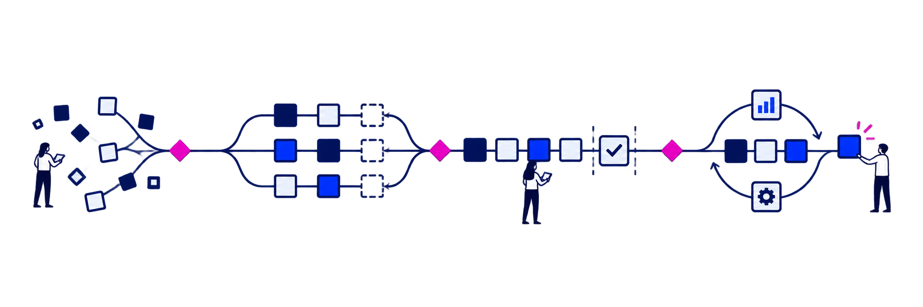
AI is transforming work across the entire life cycle.
AI agents can observe how work happens, generate and build alternatives, automate testing, and manage routine maintenance—while leaders retain accountability.
Rationalize
Build
Sustain
1
Reconstruct the current
2
Explore possible futures
3
Build and prove
4
Preserve and improve
Observe business operators and capture how work is actually performed
Reconstruct processes, decisions, handoffs, and exceptions
Connect business context to applications, data, integrations, and code
Surface pain points, controls, dependencies, and modernization priorities
Generate alternative workflows, experiences, and target architectures
Create rapid prototypes that make options tangible
Simulate process changes and compare trade-offs before committing
Enable users and leaders to validate direction before major investment
Agents write code, documentation, and change records
Accelerate test design and automated test creation
Clean, transform, and analyze data for migration and validation
Build bounded increments and compare legacy and modern behavior
Preserve process, technical, test, and decision context
Automate low-level maintenance, dependency updates, and routine remediation
Monitor production signals and investigate incidents with human oversight
Carry operational learning into continuous improvement and the next change
© 2026 West Monroe Partners | Reproduction and/or distribution without West Monroe Partners’ prior consent is prohibited.
20
Notes:
AI accelerates evidence creation, carries context across handoffs, expands validation, and supports operating teams.
Human judgment remains responsible for intent, architecture, risk, and acceptance.
Create four moments of recognition rather than an exhaustive list.
Start with the phase where uncertainty and expert dependency are often highest.

Slide 25
AI turns operational evidence into durable capability.
A human-led progression from capturing expertise to shared understanding and lasting capability.
Focus
What AI helps do
Human judgment that matters
Capture expertise
Structure interviews and surface knowledge gaps without asking experts to write every artifact from scratch.
Experts validate context, nuance, and meaning.
Observe the work
Use consented recordings and work artifacts to map steps, handoffs, exceptions, and workarounds.
Teams explain why the work happens that way.
Analyze the systems
Examine source, architecture, data, integrations, risk, and cost to reveal constraints.
Technology leaders confirm trade-offs and boundaries.
Co-design and validate
Create process alternatives and working prototypes, then test them with users and leaders.
People decide what should change and what will work.
Transfer durable capability
Preserve operating knowledge, prepare people for new roles, and retain technical context.
Leaders own adoption, readiness, and accountability.
AI prepares evidence and first drafts; people decide what is true, what should change, and when the business is ready.
© 2026 West Monroe Partners | Reproduction and/or distribution without West Monroe Partners’ prior consent is prohibited.
15
Notes:
Use slide 14 for lifecycle-oriented audiences.
Use this version for company-wide transformation, operations, and change audiences.
The two versions use the same evidence and accountability model and should not appear together in a shorter composed deck.
Start with Rationalize, where expertise, process behavior, and technical structure must become a shared evidence base.

Slide 26
We build together alongside your teams and can scale up or down with both onshore and near-shore talent, based on your needs.
We slowly step back over time as we enable your teams to move forward with and sustain your modernization program.
Software Modernization
Once the foundation and structure is in place, we begin to step back into a supporting role as your teams take the lead, often augmenting with
near-shore resources to scale up and build faster at an attractive price point while coaching and mentoring your team members on the modern platform.
As your team gains a level of comfort and assurance in maintaining the effort, we fade into the background, often moving on to new problems to solve within the organization.
We meet you wherever you’re at. We often take a lead role in standing up the modern architecture and technology stack aligned to best practices, leaning on our onshore resources for deeper engagement with your team members.
West Monroe
Your Team
NORMING & PERFORMING
OPTIMIZING & SUSTAINING
FORMING
As we continue to partner with you on the modernization roadmap—measuring progress and reprioritizing at each planning horizon—we continually evaluate the balance of assistance required to successfully provide value.
As your teams grow confident in handling modernization efforts, we plan the roll off strategy based on your goals, while you
take on long-term sustainment of the modernized software.
We will fill gaps in your team and take a leadership role in establishing processes, architecture, and technologies—getting the modernization effort off to solid start.

Slide 27
West Monroe leads the modernization build—then transitions into an AI-enabled sustainment partner.
Your team provides the business context and validates outcomes throughout the journey.
Software Modernization
 | RATIONALIZE | BUILD | SUSTAIN
West Monroe | Portfolio and architecture review Business case and roadmap | Onshore + nearshore + offshore Design, build, test and release | Part-time expert support AI oversight and validation
Your team | Priorities and target outcomes Process and data context | Validates workflows and decisions Owns business trade-offs | Owns the product roadmap Accepts enhancements
AI agents | Code and dependency analysis Candidate scoring | Code generation and testing Documentation at speed | Routine sustainment automated On call, expert-validated
Dot scale indicates relative team size at each phase.

Slide 28
INTERNAL PICK-DECK GUIDE
IN THIS SECTION
Double-Click: Rationalize
01
Phase + outputs
02
7Rs decision framework
Show how teams align the value thesis, reconstruct reality, reimagine the capability, and plan an investable modernization path.
03
Process + system evidence
04
Roadmap + first wave
Best for buyers deciding what to modernize, which path to take, and where to start.
© 2026 West Monroe Partners | Reproduction and/or distribution without West Monroe Partners’ prior consent is prohibited.
Notes:
Source deck: Software Modernization Walking Deck_04132026.pptx.
Insert source slides 9 through 11, 13 through 14, and 15 through 31 unchanged after this divider.
Omit source slide 12 because it is the old contact call to action.
Preserve source order, formatting, metrics, client descriptors, caveats, and notes.
The source is internal and verify-before-external-reuse.
Some outcomes may be modeled or identified rather than realized, and notes may contain names not visible on slides.
Transition: After a selected proof example, bring the audience back to one specific account action.

Slide 29

Rationalization makes the portfolio clear, the modernization path actionable, and delivery ready to accelerate.
It aligns outcomes, reconstructs how work and systems operate, tests the future state, and captures context that teams and AI agents can use through build.
RATIONALIZATION
Build the shared context that makes modernization actionable
Decide at the right level: portfolio, application, capability, or module
01
02
03
04
ALIGN THE THESIS
RECONSTRUCT REALITY
REIMAGINE THE CAPABILITY
PLAN THE PATH
What outcome would justify action?
How do work and systems operate today?
What should the future capability become?
Which disposition and first wave make sense?
Decision thesis + assessment questions
Current-state process, logic, risk, and cost baseline
Testable process and experience alternatives
Disposition, economics, roadmap, and first wave
DECISION PACKAGE
Shared baseline • target process • disposition choices • economics • roadmap • first wave • reusable context for teams and AI agents
© 2026 West Monroe Partners | Reproduction and/or distribution without West Monroe Partners’ prior consent is prohibited.
16
Notes:
Rationalization operates at portfolio and application levels.
Thesis alignment prevents a predetermined-platform start.
Assessment combines business and technical evidence.
The result is an investable decision with baseline, target process, disposition, economics, change impacts, roadmap, and first wave.
The hardest assessment problem often involves connecting what people do with what the software actually enforces.

Slide 30
The 7Rs provide a common decision language—and AI makes deeper modernization paths more affordable.
Apply the framework at the application, capability, or module level; it is a neutral choice set, not a sequence or maturity model.
PRESERVE OR MOVE
REMOVE OR REPLACE
REBUILD OR REIMAGINE
1
4
5
2
3
6
7
RETAIN
REHOST
REPLATFORM
RETIRE
REPURCHASE
REWRITE / REARCHITECT
REIMAGINE
Keep and manage deliberately
Move infrastructure; limit functional change
Change runtime; preserve most behavior
Remove obsolete software or work
Move the capability to packaged software
Rebuild software or materially change structure
Redesign the capability and experience
AI CHANGES THE ECONOMICS
UNDERSTAND
GENERATE
VALIDATE
AI accelerates the evidence and delivery work that historically made high-change paths slow and expensive.
Map code, dependencies, process evidence, and business rules faster.
Draft target designs, code, tests, migration assets, and documentation.
Compare options, expose risk, and expand regression coverage before release.
The framework still guides the decision; AI broadens the feasible set. Business and technology leaders remain accountable for the choice.
© 2026 West Monroe Partners | Reproduction and/or distribution without West Monroe Partners’ prior consent is prohibited.
13
Notes:
The decision can apply at portfolio, system, domain, or component level.
One disposition for a whole monolith can hide better options.
Industry 7R labels vary, and this working set aligns to the internal West Monroe disposition model.
The historical method and decision set remain. AI changes how teams perform the work across Rationalize, Build, and Sustain.

Slide 31


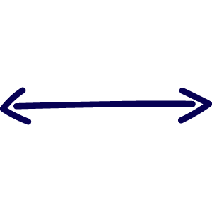

AI reconstructs business processes by tracing work, encoded logic, and expert intent into one validated model.
Each evidence stream has blind spots; the value comes from linking sources, surfacing contradictions, and keeping experts in the validation loop.
1 GATHER EVIDENCE
2 SYNTHESIZE
3 VALIDATE
4 ACTIVATE
OBSERVED WORK
Consented recordings, traces, artifacts
AI builds a candidate process + business-logic model
EXPERT REVIEW
VALIDATED MODEL
Steps • handoffs • exceptions • workarounds
Operators and business + technology experts decide what is:
Current-state process
ENCODED BEHAVIOR
Source, configuration, data, jobs, interfaces
Business rules + exceptions
Rules • states • validations • dependencies
accurate • obsolete
material • missing
Dependencies + risks
EXPERT CONTEXT
Source-linked • confidence-scored • gaps flagged
Open decisions for target design
Interviews, policies, procedures, documents
Human judgment governs the model
Intent • vocabulary • variation • judgment
DESIGN HANDOFF
Evidence moves directly into target-process design, experience prototyping, backlog creation, and test planning.
Guardrail: observation requires consent and appropriate privacy, security, access, retention, and workforce controls.
© 2026 West Monroe Partners | Reproduction and/or distribution without West Monroe Partners’ prior consent is prohibited.
17
Notes:
Each evidence source has blind spots. AI accelerates extraction and synthesis.
Experts establish meaning and decide which legacy behavior belongs in the future.
Evolve contributes source-backed code, component, integration, dependency, and selected functional evidence.
The wider delivery method supplies consented observation, interview synthesis, and business validation.
Guardrail: Do not imply that Evolve watches employees. Any observation method requires consent plus privacy, security, access, retention, and workforce controls.
Treat AI findings as candidates until qualified experts validate them.
Once the organization approves a direction, the evidence should move directly into design and delivery.

Slide 32
INTERNAL PICK-DECK GUIDE
IN THIS SECTION
Double-Click: Modernize / Build
01
Four subphases
02
Agent-ready context
Show how approved outcomes and evidence become working capability through design, build, validation, transition, and controlled cutover.
03
Phased cutover
04
Human decision gates
Best for buyers focused on execution speed, delivery risk, validation, and transition.
© 2026 West Monroe Partners | Reproduction and/or distribution without West Monroe Partners’ prior consent is prohibited.
Notes:
Source deck: Software Modernization Walking Deck_04132026.pptx.
Insert source slides 9 through 11, 13 through 14, and 15 through 31 unchanged after this divider.
Omit source slide 12 because it is the old contact call to action.
Preserve source order, formatting, metrics, client descriptors, caveats, and notes.
The source is internal and verify-before-external-reuse.
Some outcomes may be modeled or identified rather than realized, and notes may contain names not visible on slides.
Transition: After a selected proof example, bring the audience back to one specific account action.

Slide 33
Build converts rationalization outputs and evidence into working capability through four connected subphases.
Design, build, validate, and transition repeat in waves—while leaders retain authority over architecture, quality, release, and fallback.
TESTABLE PROTOTYPES
BOUNDED INCREMENTS
TRACEABLE EVIDENCE
CONTROLLED WAVES
1
DESIGN
2
BUILD
3
VALIDATE
4
TRANSITION
Translate approved outcomes, process evidence, and constraints into target journeys, architecture choices, and prototypes users can test.
Give delivery teams and agents bounded requirements, rules, dependencies, and decisions to create software, integration, and data increments.
Convert legacy behavior, controls, and edge cases into tests; compare old and new outcomes; resolve gaps with traceable evidence.
Move viable capability slices into use through phased cutover, data preparation, runbooks, learning, support, and monitored release.
User feedback shapes the target before change becomes expensive.
Work is delivered in bounded, reviewable capability increments.
Known rules and edge cases become traceable acceptance evidence.
Each viable slice moves through readiness, release, and support.
DECISION GATES
Leaders approve architecture, security, quality, acceptance, release, and fallback decisions at the appropriate point in each wave.
© 2026 West Monroe Partners | Reproduction and/or distribution without West Monroe Partners’ prior consent is prohibited.
18
Notes:
AI-assisted building still requires production engineering, security, quality, and architecture discipline.
Validation begins during design and build.
Transition includes data, operating procedures, users, controls, and release work.
The unit of progress should be a viable process or capability slice the business can use and validate.
Transition: Reusing the evidence from rationalization can eliminate a large amount of rediscovery during build.

Slide 34
Persistent, agent-ready context from rationalization can compress the path from prototype to production during build.
A governed evidence base and business process map reduce rediscovery by giving teams and AI agents bounded, source-linked context for each delivery task.
CONTEXT CARRIED FORWARD
BUILD WORK ACCELERATED
Evidence database
AGENT-READY CONTEXT LAYER
1
PROTOTYPE
Source code, components, data, integrations, controls, dependencies, and confidence.
Connect the evidence so an agent can traverse the work:
Generate options grounded in current behavior, constraints, and target outcomes.
Faster user feedback
PROCESS
what the business does
2
REQUIREMENTS
Business process map
Draft traceable stories, acceptance criteria, and edge cases from known evidence.
RULE
what must remain true
Process steps, rules, exceptions, users, outcomes, and pain points linked to technology.
Less rediscovery
COMPONENT
where behavior lives
3
IMPLEMENTATION
Provide teams and agents the relevant rules, dependencies, and design decisions.
REQUIREMENT
what must change
Decision trail
Higher first-pass relevance
Approved outcomes, architecture choices, open questions, and expert rationale with provenance.
TEST
how correctness is proven
4
VALIDATION
Bounded retrieval • source links • versions • approvals • permissions • uncertainty
Turn known states, controls, and exceptions into tests and comparison evidence.
Earlier defect discovery
THE SHIFT
Move from rediscovering context for every task to retrieving the right context for the next task—while human review and testing remain authoritative.
© 2026 West Monroe Partners | Reproduction and/or distribution without West Monroe Partners’ prior consent is prohibited.
19
Notes:
Unified context is the strategic idea.
A knowledge graph is one possible implementation pattern and is not a claim of a fully delivered product.
Context needs provenance, versioning, permissions, and clear separation of evidence from inference.
Stale context can accelerate the wrong work.
Human review and testing determine correctness.
Transition: Cutover is a high-value use of connected context because planning, preparation, and monitoring depend on business, data, control, and technology evidence.

Slide 35
AI can orchestrate phased cutover by sequencing capability slices, preparing each wave, and monitoring legacy–modern coexistence.
Because modernization rarely happens in one big bang, cutover decisions must combine process, data, control, user, and technical evidence across every wave.
AI SUPPORT ACROSS EVERY WAVE
1
SEQUENCE
2
PREPARE
3
MONITOR
Identify viable capability slices, expose hidden dependencies, and simulate fallback paths.
Profile and map data; generate UAT scenarios, runbooks, communications, learning, and support drafts.
Compare transactions and outcomes, flag exceptions, and trace anomalies to known dependencies.
ILLUSTRATIVE PHASED CUTOVER
CURRENT STATE
WAVE 1
WAVE 2
WAVE 3
CAPABILITY SLICE A
LEGACY
COEXISTENCE
MODERN
MODERN
CAPABILITY SLICE B
LEGACY
LEGACY
COEXISTENCE
MODERN
CAPABILITY SLICE C
LEGACY
LEGACY
LEGACY
COEXISTENCE
PEOPLE CONTROL GO / NO-GO, FALLBACK, DATA CHANGES, RISK ACCEPTANCE, AND RETIREMENT; AI SURFACES EVIDENCE AND RECOMMENDATIONS.
The migration unit is a business-viable capability slice—not simply a technical component.
© 2026 West Monroe Partners | Reproduction and/or distribution without West Monroe Partners’ prior consent is prohibited.
20
Notes:
A clean technical boundary may not be a viable end-to-end process.
Planning covers edge cases, dependencies, fallback, and decision evidence.
Preparation includes data quality and operational readiness.
Monitoring covers business outcomes and data health alongside technical signals.
AI surfaces evidence and recommendations. People decide release and fallback.
Transition: Once the first slice goes live, sustainment begins and decommissioning becomes part of the value case.

Slide 36
INTERNAL PICK-DECK GUIDE
IN THIS SECTION
Double-Click: Sustain
01
Operate + evolve
02
Living knowledge base
Show how modernization value is sustained through operating discipline, continuous evolution, knowledge retention, and verified decommissioning.
03
Decommission legacy
04
Realize full economics
Best for buyers concerned with long-term ownership, support cost, resilience, and continuous improvement.
© 2026 West Monroe Partners | Reproduction and/or distribution without West Monroe Partners’ prior consent is prohibited.
Notes:
Source deck: Software Modernization Walking Deck_04132026.pptx.
Insert source slides 9 through 11, 13 through 14, and 15 through 31 unchanged after this divider.
Omit source slide 12 because it is the old contact call to action.
Preserve source order, formatting, metrics, client descriptors, caveats, and notes.
The source is internal and verify-before-external-reuse.
Some outcomes may be modeled or identified rather than realized, and notes may contain names not visible on slides.
Transition: After a selected proof example, bring the audience back to one specific account action.

Slide 37
Sustain: operate, evolve, and finish decommissioning
A living knowledge base reduces dependence on a few experts and gives the next change a stronger starting point.
OPERATE AND EVOLVE
DECOMMISSION
CORE WORK
CORE WORK
Establish ownership, service levels, observability, security, cost management, and a product backlog.
Keep process, rule, architecture, decision, test, runbook, and operating knowledge current.
Remove old code, infrastructure, data paths, interfaces, jobs, licenses, support arrangements, and manual controls.
Find remaining dependencies and consumers before retirement decisions.
AI CONTRIBUTION
AI CONTRIBUTION
Assist incident triage, impact analysis, documentation, test maintenance, and backlog development using governed context.
Trace dependencies and transfer the business, control, data, and support knowledge that must survive.
OUTPUT
Operating model, product roadmap, and measured service and business performance
OUTPUT
Verified retirement, closed controls, ended dual run, and realized savings
Full value requires both improvement and verified retirement.
© 2026 West Monroe Partners | Reproduction and/or distribution without West Monroe Partners’ prior consent is prohibited.
21
Notes:
Sustainment turns a project into a product capability.
Rich documented context prevents tribal knowledge from reappearing, lowers critical-person risk, and accelerates future change.
Agentic maintenance may change long-term labor economics, but that requires measured pilots and defined controls.
Transition: The cost case must include every phase, especially dual run, operation, and decommissioning.

Slide 38
Maintain, buy, and build economics
Three valid paths. One consistent view of transition cost, operating cost, value, and risk.
01
02
03
MAINTAIN AND REPAIR
BUY AND ADAPT
BUILD OR REBUILD
THE LEGACY SYSTEM
A PACKAGED PLATFORM
BUSINESS-FIT SOFTWARE
SHARED COST AND VALUE LENS
1
Analysis, design, implementation, and testing
2
Data migration, integrations, security, compliance, and controls
3
Licensing, infrastructure, labor, support, and model or tooling cost
4
Process change, customization, training, adoption, and workarounds
5
Transition, dual run, operational risk, decommissioning, and time to value
6
Enhancements, maintenance, incidents, flexibility, and opportunity cost
Apply measured AI gains to the workstreams they affect, then compare the full transition and operating economics.
© 2026 West Monroe Partners | Reproduction and/or distribution without West Monroe Partners’ prior consent is prohibited.
22
Notes:
Lower analysis, coding, testing, and maintenance cost can make business-fit build competitive across more capabilities.
Packaged software may remain best for standardized capabilities.
Business-fit software becomes more interesting when differentiation, customization, licensing, or integration burden is high.
Savings begin after transition and decommissioning.
Transition: The build-versus-buy calculus has changed, but the answer remains client-specific.

Slide 39
INTERNAL PICK-DECK GUIDE
SECTION PLACEHOLDERS
Modernization Accelerators & Assets
01
OCM AI Studio
02
Intellio Hopper
Provide one view of the methods, platforms, and reusable assets that accelerate modernization across people, process, technology, and delivery.
03
Intellio Evolve
04
Supporting assets
PLACEHOLDER SECTION — Confirm the complete asset inventory, lifecycle fit, owners, maturity, and approved claims.
© 2026 West Monroe Partners | Reproduction and/or distribution without West Monroe Partners’ prior consent is prohibited.
Notes:
Source deck: Software Modernization Walking Deck_04132026.pptx.
Insert source slides 9 through 11, 13 through 14, and 15 through 31 unchanged after this divider.
Omit source slide 12 because it is the old contact call to action.
Preserve source order, formatting, metrics, client descriptors, caveats, and notes.
The source is internal and verify-before-external-reuse.
Some outcomes may be modeled or identified rather than realized, and notes may contain names not visible on slides.
Transition: After a selected proof example, bring the audience back to one specific account action.

Slide 40
INTERNAL PICK-DECK GUIDE
CONTENT TO DEVELOP
OCM AI Studio
01
Change impacts (TBD)
02
Role + readiness insights
Placeholder for how OCM AI Studio supports people and change outcomes within modernization programs.
03
Communications + learning
04
Adoption measures
PLACEHOLDER SECTION — Confirm product positioning, modernization use cases, demo assets, owner, maturity, and proof.
© 2026 West Monroe Partners | Reproduction and/or distribution without West Monroe Partners’ prior consent is prohibited.
Notes:
Source deck: Software Modernization Walking Deck_04132026.pptx.
Insert source slides 9 through 11, 13 through 14, and 15 through 31 unchanged after this divider.
Omit source slide 12 because it is the old contact call to action.
Preserve source order, formatting, metrics, client descriptors, caveats, and notes.
The source is internal and verify-before-external-reuse.
Some outcomes may be modeled or identified rather than realized, and notes may contain names not visible on slides.
Transition: After a selected proof example, bring the audience back to one specific account action.

Slide 41
INTERNAL PICK-DECK GUIDE
CONTENT TO DEVELOP
Intellio Hopper
01
Positioning (TBD)
02
Modernization use cases
Placeholder for Intellio Hopper's role in modernization and how it complements other West Monroe accelerators.
03
Lifecycle fit
04
Proof + owner
PLACEHOLDER SECTION — Add approved capabilities, inputs / outputs, maturity, buyer relevance, and case evidence.
© 2026 West Monroe Partners | Reproduction and/or distribution without West Monroe Partners’ prior consent is prohibited.
Notes:
Source deck: Software Modernization Walking Deck_04132026.pptx.
Insert source slides 9 through 11, 13 through 14, and 15 through 31 unchanged after this divider.
Omit source slide 12 because it is the old contact call to action.
Preserve source order, formatting, metrics, client descriptors, caveats, and notes.
The source is internal and verify-before-external-reuse.
Some outcomes may be modeled or identified rather than realized, and notes may contain names not visible on slides.
Transition: After a selected proof example, bring the audience back to one specific account action.

Slide 43
INTERNAL PICK-DECK GUIDE
IN THIS SECTION
Intellio Evolve
01
Platform overview
02
Business-led rationalization
Explain how Evolve turns source-backed application evidence into modernization recommendations, sequencing, and reusable context for delivery.
03
Evidence to recommendations
04
Build + Sustain context
Use this section when software rationalization, legacy understanding, sequencing, or agent-ready context is central.
© 2026 West Monroe Partners | Reproduction and/or distribution without West Monroe Partners’ prior consent is prohibited.
Notes:
Source deck: Software Modernization Walking Deck_04132026.pptx.
Insert source slides 9 through 11, 13 through 14, and 15 through 31 unchanged after this divider.
Omit source slide 12 because it is the old contact call to action.
Preserve source order, formatting, metrics, client descriptors, caveats, and notes.
The source is internal and verify-before-external-reuse.
Some outcomes may be modeled or identified rather than realized, and notes may contain names not visible on slides.
Transition: After a selected proof example, bring the audience back to one specific account action.

Slide 44
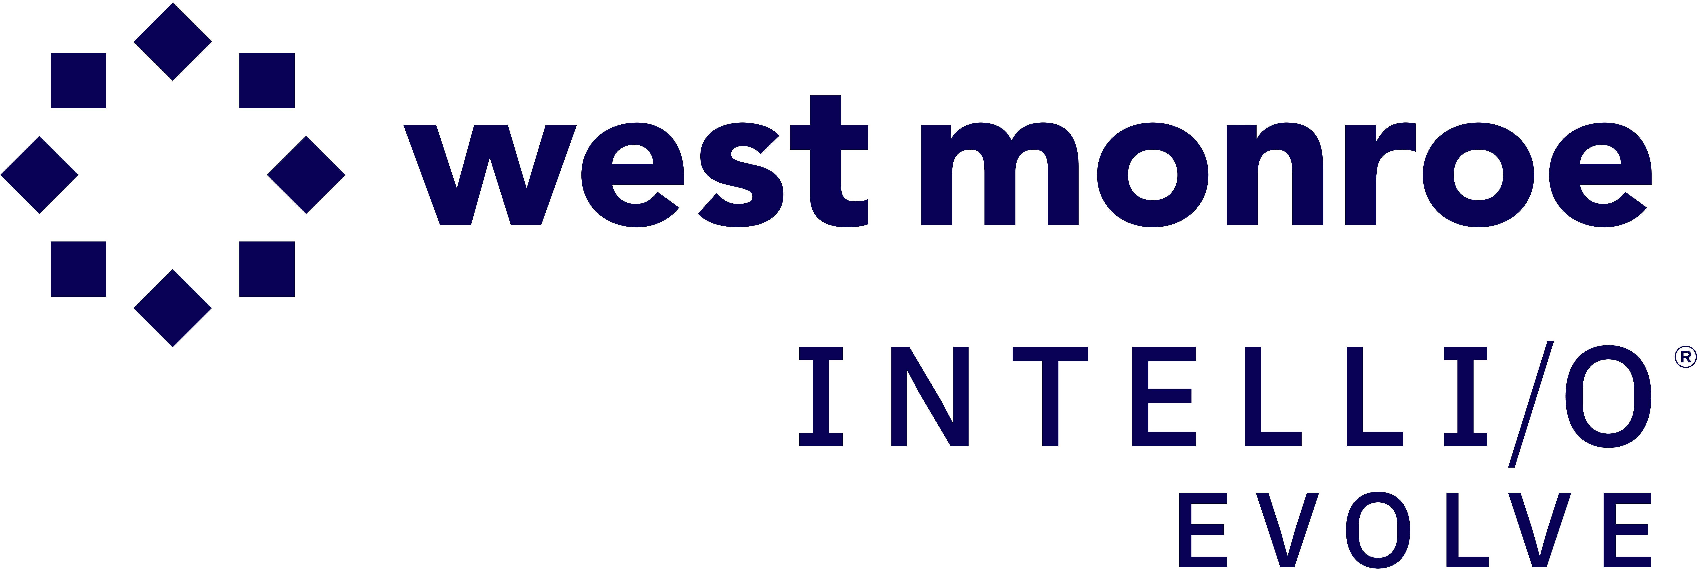
Intellio® Evolve combines AI with advanced code analysis to guide modernization that not only rebuilds code but enhances the product itself.
SOFTWARE MODERNIZATION
Unlike coding agents, Intellio® Evolve goes beyond just code modernization. It deepens legacy software understanding—converting “tribal knowledge” into structured insight. And it combines agentic workflows and an AI-powered SDLC delivery approach with co-creation alongside client teams to ensure a successful and sustained transformation.
PURPOSE-BUILT TO ACCELERATE
Multiple Engagement Modes
CLI, Hub UI, MCP, and API—local
or cloud
Agentic Intelligence
Queries and updates evidence from
user input and code findings
Flexible Storage
SQLite for portability, PostgreSQL,
or Neo4j for scale
Built for Delivery Teams
Consultants, engineers, and coding agents working together
ANALYSIS INPUTS
Source Code
OOABL / OpenEdge
C# / .NET
PowerHouse
Java  Python  COBOL
Documentation
Specs, runbooks, wiki
Data Dictionaries
Schemas, ERDs, configs
INTEGRATIONS
Coding Agents
Claude / Anthropic
Codex / OpenAI
Cursor
Project Trackers
Jira, Azure DevOps
CI / CD
GitHub Actions
Azure Pipelines
Agentic Intelligence: Queries, enriches, and updates evidence from user input and source analysis
Evidence Database
SQLite ⎜ PostgreSQL ⎜ Neo4j
Analysis engine
MCP server
Reports & chat
Planning tools
VALUE
DELIVERED
Less than 12 months
to modernize, where it used to take 3–5 years
10+ pre-built workflows
leveraging AI for code understanding and rebuild
Up to 80% savings
in migration and re-engineering effort
Notes:
Coding agents help developers write code faster (improve developer efficiency). Intellio Evolve helps enterprises modernize entire systems—faster, smarter, and with better business outcomes (40-50% faster modernization timelines).
Intellio Evolve includes prompt-engineered purpose-built workflows for modernization. Coding agents require users to design prompts, workflows, and guardrails manually.
Intellio Evolve helps modernize software based on current business needs, not just converting old code into new code. Coding agents primarily generate or refactor code based on prompts.
Intellio Evolve deepens legacy software understanding (context at scale). It uses AI to analyze legacy codebases (COBOL, .NET, AngularJS, etc.), map dependencies and business logic and converts “tribal knowledge” into structured insight. Coding agents are limited to what fits within a prompt/context window.
Software modernization is as much architecture + change + business alignment as code modernization. Intellio Evolve combines agentic workflow + AI in SDLC delivery approach + co-creation with client teams. Coding agents are pure tools with no embedded delivery approach.

Slide 45
Intellio® Evolve turns legacy-system complexity into a business-led modernization roadmap.
BUSINESS-LED MODERNIZATION
Evolve connects business priorities to the processes, systems, and dependencies behind them—then recommends where to start, what to change, and how to sequence the work. The result is a practical starting point for operational, finance, product, and technology leaders.
BUILT FOR OUTCOME-LED CHANGE
Start with outcomes
Anchor decisions in service, speed, accuracy, resilience, and cost
Explain the why
Make evidence, assumptions, tradeoffs, and rationale reviewable
Sequence the change
Show what moves first, what moves together, and what can follow
Align business & technology
BUSINESS PRIORITIES
Service & experience
Speed, access, accuracy
Operational performance
Cycle time, productivity
Risk & constraints
Controls, regulation, budget
BUSINESS OUTPUTS
Roadmap
Prioritized work packages
Sequenced releases
Investment Case
Value, effort, risk
Execution Alignment
Owners, decisions, milestones
Decision Intelligence: Connects priorities to evidence, tradeoffs, and choices
Shared Modernization View
Processes | systems | dependencies
Process insights
Risk & dependencies
Recommendations
Sequencing tools
VALUE
DELIVERED
Faster time to value
focus investment on highest-value work
Lower delivery risk
surface dependencies before execution
Stronger adoption
coordinate process and technology change
Notes:
Coding agents help developers write code faster (improve developer efficiency). Intellio Evolve helps enterprises modernize entire systems—faster, smarter, and with better business outcomes (40-50% faster modernization timelines).
Intellio Evolve includes prompt-engineered purpose-built workflows for modernization. Coding agents require users to design prompts, workflows, and guardrails manually.
Intellio Evolve helps modernize software based on current business needs, not just converting old code into new code. Coding agents primarily generate or refactor code based on prompts.
Intellio Evolve deepens legacy software understanding (context at scale). It uses AI to analyze legacy codebases (COBOL, .NET, AngularJS, etc.), map dependencies and business logic and converts “tribal knowledge” into structured insight. Coding agents are limited to what fits within a prompt/context window.
Software modernization is as much architecture + change + business alignment as code modernization. Intellio Evolve combines agentic workflow + AI in SDLC delivery approach + co-creation with client teams. Coding agents are pure tools with no embedded delivery approach.

Slide 46
Intellio Evolve turns application evidence into modernization guidance and sequencing
Evolve treats evidence as more than reports: source code, dependency and call graphs, data use, integrations, and functional boundaries. It uses that evidence to recommend modernization options and a sequenced starting point for human review.
HOW EVOLVE SUPPORTS DECISIONS
BUILD AN EVIDENCE BASE
Inventory source code, languages, frameworks, files, calls, dependencies, data use, integrations, components, and functional boundaries.
EVIDENCE TO GUIDED ACTION
GENERATE RECOMMENDATIONS
SOURCE CODE AND APPLICATION METADATA
Translate evidence into modernization options, target-state considerations, risks, dependencies, and candidate work packages.
STRUCTURAL + DEPENDENCY GRAPHS
PROPOSE SEQUENCING
MODERNIZATION RECOMMENDATIONS AND OPTIONS
Suggest where to start and how initiatives may sequence based on coupling, blast radius, feasibility, and value—while preserving assumptions and uncertainty.
SEQUENCED PLAN FOR HUMAN REVIEW
Recommendations are transparent, reviewable starting points—not final decisions.
HUMAN JUDGMENT REMAINS CENTRAL
Product managers and architects validate context, weigh business priorities and constraints, and guide the final modernization roadmap. Evolve accelerates judgment; it does not replace it.
© 2026 West Monroe Partners | Reproduction and/or distribution without West Monroe Partners’ prior consent is prohibited.
23
Notes:
Evolve reduces uncertainty. It does not replace the method, delivery team, client experts, or governance.
Strong current workflows include workflow discovery, functional specification, QA extraction, workflow-to-wireframe, and integration rollup.
Security CVE triage is a pilot or scaffold, and several planning workflows are advisory.
Transition: Evolve's strongest and most direct role sits inside Rationalize, where it builds the source-backed evidence base for the modernization decision.

Slide 47
Evolve builds an evidence base during Rationalize, runs analysis workflows, and develops a context database used during the Build phase.
A connected journey from source-backed findings to business-owned decisions.
01
02
03
04
THESIS ALIGNMENT
ASSESSMENT
REIMAGINE
PLAN
EVOLVE EVIDENCE
EVOLVE EVIDENCE
EVOLVE EVIDENCE
EVOLVE EVIDENCE
Repository scope, technology signals, available evidence, known uncertainty.
Source inventory, structure, routines, calls, data use, dependencies, integrations, components, functional boundaries, coverage, and ambiguity.
Validated current behavior and constraints available to selected functional specification and workflow or wireframe activities.
Source references, dependency and impact evidence, reports, scenarios, and planning artifacts.
WIDER-TEAM DECISION
WIDER-TEAM DECISION
WIDER-TEAM DECISION
WIDER-TEAM DECISION
Set catalyst, outcome, criteria, business scope, measures, and the investment question.
Observe work, interview experts, assess process, business value, risk and cost, and validate what findings mean.
Choose what to preserve, remove, redesign, automate, buy, or build. Test target process, experience, architecture, and value hypotheses.
Select dispositions, build the business case, set roadmap and governance, and approve the first viable wave.
Evolve builds the technical and functional evidence layer. West Monroe and client experts connect that evidence to business intent and make the modernization decisions.
© 2026 West Monroe Partners | Reproduction and/or distribution without West Monroe Partners’ prior consent is prohibited.
24
Notes:
Assessment is Evolve's strongest current product position.
Evolve can help reconstruct candidate functional behavior from source.
It does not observe employee work or determine business purpose by itself.
It supports decisions and does not autonomously choose architecture, disposition, investment, or roadmap.
Transition: A security scan provides one concrete example of how code evidence can make a large technical inventory more actionable.

Slide 48
From security scan findings to a reviewable remediation plan
INPUTS
Structured CVE or scanner findings • relevant source repository and Evolve evidence store • component, dependency, integration, and business-criticality context
01
02
03
04
05
NORMALIZE THE INVENTORY
CONNECT FINDINGS TO THE SYSTEM
REVIEW APPLICABILITY
PRIORITIZE REMEDIATION
PREPARE THE PLAN
Organize findings, affected packages or components, severity, scanner evidence, and missing information.
Map candidate issues to source-linked components, dependencies, code paths, integrations, and potential blast radius where evidence supports it.
Flag supporting evidence, possible duplication, uncertain reachability, compensating controls, and false-positive questions for a security specialist.
Consider severity with business criticality, exposure, dependencies, operational risk, and cost of delay.
Produce a reviewable package with evidence links, affected areas, candidate actions, sequencing, validation tests, estimation questions, and owners.
HUMAN CONTROL
Security and engineering specialists confirm applicability, exploitability, remediation, testing, and risk acceptance.
PILOT OR SCAFFOLD
The audited product accepts structured CVE inputs and includes a triage handler and artifact outputs, but the default production runner is unavailable. Position as a pilot until the product owner confirms a production-ready execution path and evidence from real use.
© 2026 West Monroe Partners | Reproduction and/or distribution without West Monroe Partners’ prior consent is prohibited.
25
Notes:
The value hypothesis is contextual triage.
Do not claim that Evolve automatically proves false positives, establishes exploitability, or generates production-ready remediation.
The same pattern can support diligence, technical-debt planning, post-close remediation, or a security-led catalyst.
Transition: The source-backed context built during Rationalize can continue creating value during Build and Sustain.

Slide 49
Evolve context supports Build and Sustain
Source-linked context can carry approved evidence forward when each task retrieves only what it needs.
SHARED FOUNDATION
BUILD
Source-backed Evolve evidence
HOW CONTEXT IS USED
VALUE OPPORTUNITY
Retrieve relevant process, rules, requirements, source references, components, data, integrations, dependencies, acceptance criteria, and open questions for a bounded design, coding, testing, migration, or cutover task.
Warmer handoffs, less repeated discovery, faster prototyping, more targeted agent prompts, stronger traceability, earlier identification of impacts and gaps.
Validated business-process context
Approved decisions
SUSTAIN
Current delivery artifacts
HOW CONTEXT IS USED
VALUE OPPORTUNITY
Connect bug reports and feature requests to documented intent, process behavior, architecture, dependencies, prior decisions, tests, and operating knowledge. Support impact analysis, code investigation, regression-test maintenance, documentation, and backlog refinement.
Faster investigation and change, better knowledge preservation, and a potential reduction in maintenance and evolution labor.
Governed retrieval connects the foundation to bounded work.
CURRENT EVOLVE CAPABILITY
AI-ENABLED WEST MONROE DELIVERY METHOD
FUTURE OR PILOT CAPABILITY REQUIRING PROOF
The context layer compounds in value only when teams keep it current, governed, source-linked, and available through retrieval tools.
© 2026 West Monroe Partners | Reproduction and/or distribution without West Monroe Partners’ prior consent is prohibited.
26
Notes:
Evolve currently stores source-backed evidence and exposes targeted context through Hub APIs, reports, and MCP-connected tools.
The broader context also needs interviews, consented observation, target designs, requirements, decisions, change artifacts, and operational records.
Build continuity is the strongest near-term story.
Avoid saying Evolve modernizes the application. Say it creates and exposes evidence that helps people and agents make and execute modernization decisions.
Transition: The same lifecycle appears through different business processes in each target industry.

Slide 50
Industry patterns make the opportunity concrete
Representative patterns help connect the lifecycle to real processes without assuming every company has the same need.
HEALTHCARE DELIVERY
PATTERN
Patient access, referral, and scheduling orchestration. Revenue-cycle and authorization work queues.
CATALYST
Process friction, acquisition complexity, staffing pressure, patient experience.
HEALTH PLANS
PATTERN
Claims and benefit-rule logic, enrollment and billing, prior authorization, provider data.
CATALYST
Product-change speed, regulatory change, manual exceptions, AI readiness.
TRADITIONAL INSURANCE
PATTERN
Policy administration and rating, underwriting workbench, claims orchestration, commissions.
CATALYST
Growth, product speed, expert dependency, platform end of life.
CONSUMER PRODUCTS
PATTERN
Pricing and trade promotion, order allocation and returns, product data and labeling.
CATALYST
Margin leakage, slow change, channel growth, ERP customization burden.
INDUSTRIAL PRODUCTS
PATTERN
Configure-price-quote and engineer-to-order, production planning, field service, quality and traceability.
CATALYST
Expert concentration, downtime, service growth, plant-system complexity.
Consequential process + modernization catalyst + opaque logic or dependencies + access to source and experts + a real choice among paths.
© 2026 West Monroe Partners | Reproduction and/or distribution without West Monroe Partners’ prior consent is prohibited.
27
Notes:
These are opportunity hypotheses, not claims that every company has the problem.
Evolve fit is strongest where meaningful custom or custom-modified source is available.
Packaged-platform opportunities may focus on custom extensions, satellite applications, integrations, batch jobs, and surrounding workflows.
Tailor this module to the audience in a composed deck.
Transition: Select the most relevant proof story from the case-study appendix to make the lifecycle and economic shift tangible.

Slide 51
APPENDIX
SELECTION CUES
Existing West Monroe modernization case-study library
01
Industry and operating model
02
Catalyst and decision window
Select the one or two proof stories that best match the audience, catalyst, and modernization pattern.
03
Technology pattern and lifecycle stage
04
Evidence and reuse status
Internal pick-deck appendix. Verify every case before external reuse.
© 2026 West Monroe Partners | Reproduction and/or distribution without West Monroe Partners’ prior consent is prohibited.
28
Notes:
Source deck: Software Modernization Walking Deck_04132026.pptx.
Insert source slides 9 through 11, 13 through 14, and 15 through 31 unchanged after this divider.
Omit source slide 12 because it is the old contact call to action.
Preserve source order, formatting, metrics, client descriptors, caveats, and notes.
The source is internal and verify-before-external-reuse.
Some outcomes may be modeled or identified rather than realized, and notes may contain names not visible on slides.
Transition: After a selected proof example, bring the audience back to one specific account action.

Slide 52
Our team has executed dozens of software modernization strategy and build engagements across industries. (1 of 3)
SOFTWARE MODERNIZATION
  East Coast Electric & Gas Utility: Energy & Utilities
Healthcare Professional Association: Life Sciences
  Modernized client’s data staging platform administration app which was 7 years old. Rewrote core presentation layer from AngularJS to Angular, upgraded web servers, upgraded .NET API layer, and created DevOps CI/CD pipelines.
  Created modernization strategy for decades-old COBOL application at the center of client’s business, which was hindering innovation and agility. Designed modern microservices architecture with implementation plan to decompose application and deploy services.
Fortune 200 Electric & Gas Utility: Energy & Utilities
Healthcare Professional Association: Life Sciences
  Modernized a solar interconnection web app from AngularJS to Angular, improving maintainability and efficiency. Re-wrote pages using Agile methods, driving feature parity alongside stakeholder input. Executed a pilot phase with parallel legacy and modern UIs to ensure seamless business user transition.
  Assessed and rewrote a critical customer-facing app ahead of an urgent AngularJS end-of-life deadline within five months. Conducted architecture reviews, built backlog, and led iterative development. Enhanced security and repeatable patterns with a modern codebase ready for future enhancements.
Large Airline: Aviation
Lab & Diagnostic Testing Provider: Life Sciences
  Transformed client’s app dev practices by refactoring core reservation system into microservices. Improve scalability through IBM Garage methodologies, Cloud Foundry, and Google Kubernetes Engine. Established end-to-end CI/CD pipeline in Jenkins to achieve instant blue/green deployments.
  Redesigned and converted large sections of legacy .NET MVC codebase to .NET Core and Angular. Worked with customer success team to provide supporting documentation and advised on transition plan to cutover to new UX and functionality.
Notes:
Con Edison EDAP Admin modernization
Exelon Intellio Connect UI Modernization
American Airlines
CAP SCORES Strategy
CAP RFDE Rewrite
Renovo Modernization

Slide 53
Our team has executed dozens of software modernization strategy and build engagements across industries. (2 of 3)
SOFTWARE MODERNIZATION
  Large Video Streaming Platform Provider: High Tech & Software
Construction Company Software Provider: High Tech & Software
  Worked with Billing & Subscriptions team to simplify platform management. Established domain model to promote shared understanding, modernized the platform architecture, and updated APIs to centralize business logic, improve test coverage, and enhance communications.
  Modernized client's PRO App, integrating AI to enhance operational efficiency and cost savings. Prioritized features to reduce maintenance costs, increase usability, and improve user productivity. De-risked initial $5 million investment and identified opportunities for significant productivity improvement.
Large Video Streaming Platform Provider: High Tech & Software
Insurance Management Software Provider: High Tech & Software
  Collaborated with client teams to develop both iOS and Apple TV apps. Re-wrote and modernized the iOS app while simultaneously building the Apple TV app resulting in a successful rollout to millions of Apple TV users, with quick and efficient updates.
  Modernized client's software to enhance performance and user experience. Prioritized key features, streamlined workflows, and integrated advanced technologies to drive efficiency and innovation. Achieved significant improvements in operational capabilities and customer satisfaction.
Identity & Access Management Provider: High Tech & Software
HR Compliance Software Provider: High Tech & Software
  Created product modernization strategy through collaborative workshops and interviews while analyzing 1.2M+ lines of code. Identified 25 tech debt reduction initiatives organized into a comprehensive 2-year roadmap, with opportunities to free up 30K hours of annual developer capacity.
  Transformed a leading compliance solutions provider's legacy platform by addressing slow report processing, limited integrations, and security issues. Our agile team modernized the system using Azure and AI/ML to automate tasks and streamline workflows, reducing tech debt and optimizing costs.
Notes:
Hulu Subscriptions
Hulu iOS
Exostar Tech Debt Remediation
SAFEBuilt
Vertafore Modernization
Outsolve

Slide 54
Our team has executed dozens of software modernization strategy and build engagements across industries. (3 of 3)
SOFTWARE MODERNIZATION
  Large Packaging/Shipping Materials Provider: Consumer & Industrial Products
Large Credit Reporting Agency: High Tech & Software
  Identified key modernization targets, accelerating shift to modern services. Architected custom Java Spring microservices tier, integrating with new and legacy systems. Embedded teams quickly revamped development processes for efficiency. Accelerated client's roadmap, paving way for system retirement.
  Transformed client's offer management by modernizing their outdated system. Embedded product and development team members to design and build a system that personalizes offers using user demographics. This cut publishing and update times from 6-8 weeks to under 24 hours.
Golf Club Owner/Operator: Consumer & Industrial Products
Community Bank: Banking
  Assessed and remediated key issues in caddie booking system. Established reusable tests and metrics to measure improvement effectiveness. Implemented fixes over 10 sprints, achieving 10X performance gains. Updated to long-term support versions and added CI/CD with gatekeeping.
  Assessed client’s tech landscape, identifying risks and scalability issues. Rationalized applications; developed future state architecture and roadmap. Established maturity framework for digital. Recommended initiatives to enhance data analytics, IT governance, and technology solutions.
Large Property & Casualty Insurance Provider: Insurance
Workplace Safety & Compliance Provider: Healthcare
  Re-platformed the client's legacy, Windows-only applications to a cloud-first tech stack. Unified the customer experience by modernizing workflows and integrated five applications into a single solution. Simplified processes and improved access to support and pricing specials.
  Modernized outdated architecture to reduce risks and enable faster releases. Implemented Agile delivery process. Created .NET Core microservice and Azure-hosted SQL database to decouple occupational health domain. Replacing ASP.NET web pages with React for improved user experiences.
Notes:
Uline App Modernization
Troon Golf
First American
Experian Offers
NASB Community Bank
DISA

Slide 55
Appendix:
Detailed Modernization Client Stories
01

Slide 56
How do we avoid security risk and reduce technical debt?
CLIENT STORIES
LARGE EAST COAST UTILITY
Client identified the need for the data staging platform to be upgraded with modern and supportable technology given the end-of-life status of AngularJS, reducing technical debt and updating unsupported dependencies to modern supportable standards across the UI, API, and data layers.
Initial modernization inventory included 57 application features to be prioritized for modernization
57
  Modernization Strategy & Build
    Mobilized for the project to review existing application codebase, known issues, npgsql, and other dependencies; setup local development environments and source code repositories
    Determined target .NET version for upgrade, migrated data from existing PostgreSQL instance to new one, and refactored API functionality based on data testing
    Iteratively designed, built, and tested rewritten UI functionality in the new Angular code base, reviewing and deploying code for review with client along the way
    Facilitated client acceptance testing and knowledge transfer, prepared and validated Production deployment checklist, and supported client with production release planning including internal security compliance and code scanning activities
    Deployed new solution to PROD environment including Staging PostgreSQL migration to new instance, finalized client acceptance testing and retrospective
App Features Identified
Notes:
Con Edison EDAP Modernization

Slide 57
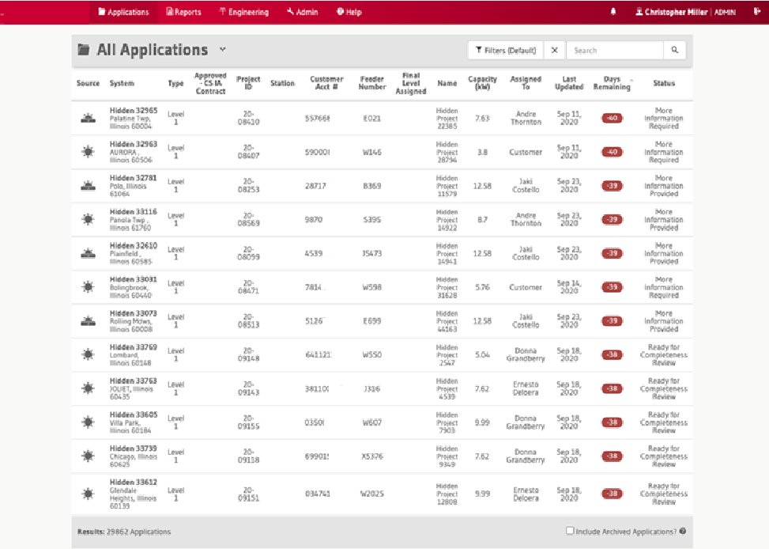
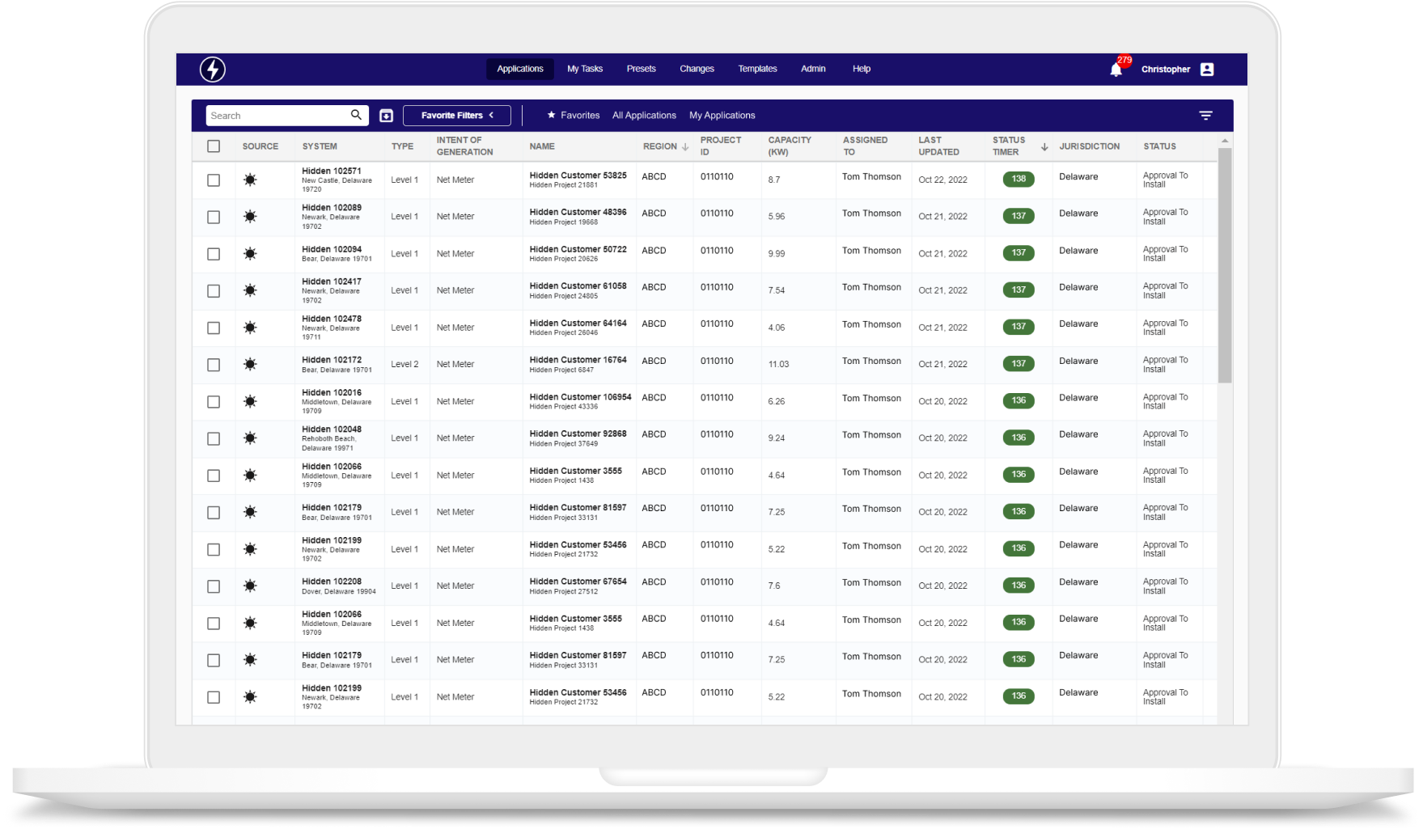
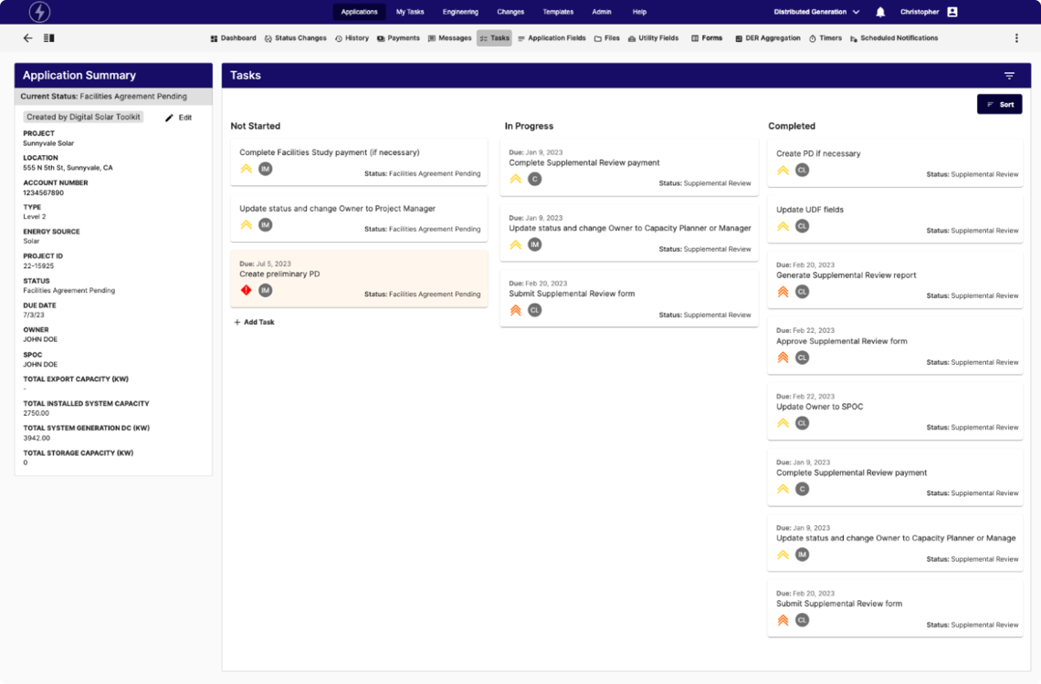
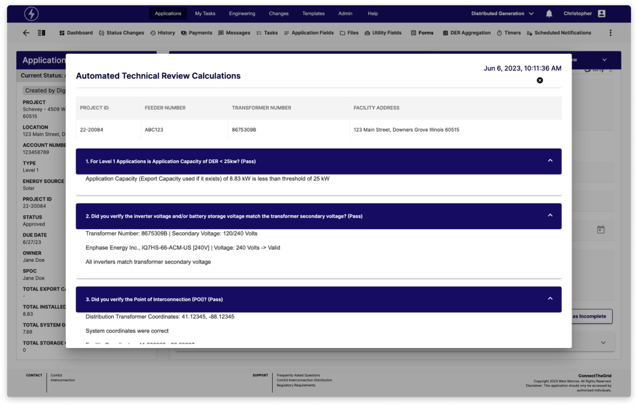
CLIENT STORIES
LARGE INVESTOR-OWNED UTILITY
How can we accelerate innovation and increase security maturity on our solar interconnection solution?
675K+
800+
Lines of code migrated
Files
modified
Client needed to modernize a decade-old solution that powers workflows for solar interconnection across their six operating companies. The application’s AngularJS front-end technology was nearing end-of-life and slowing down development team efficiency.
From this…
  Modernization Strategy & Build
    Assessed leading frameworks and recommended Angular based on key business priorities of maintainability, theming, and dynamic forms. Angular enhances maintainability with its opinionated defaults, facilitating quick project initiation and simplifying new developer onboarding. Additionally, Angular Material and Formly support dynamic theming and form generation, respectively, accelerating front-end development with robust components and JSON-based configurations.
    Our team inventoried all existing pages, rationalized which pages should carry over to the new Angular UI, re-wrote them leveraging an Agile development process, and engaged business stakeholders to validate feature parity prior to final cutover.
    Conducted pilot phase where the old and new UIs were running side by side in production to enable a seamless transition for the business.
…to this
Notes:
Exelon Intellio UI Modernization

Slide 58

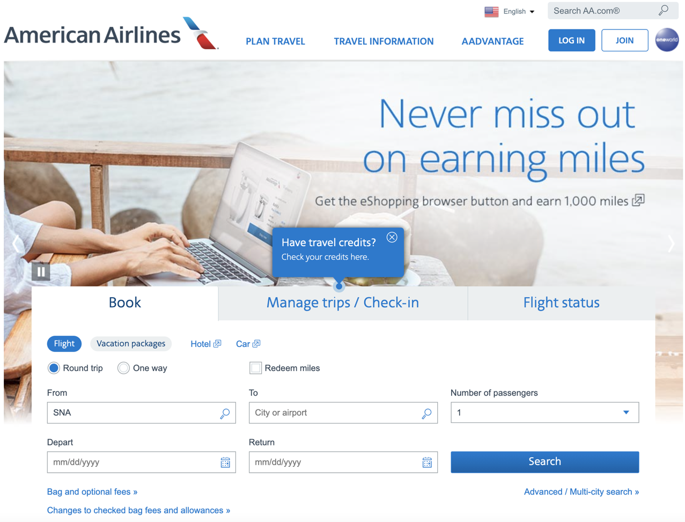

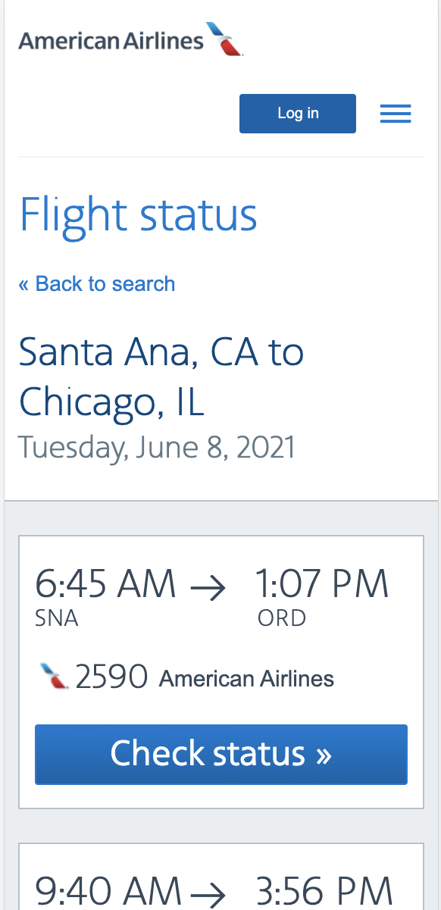
CLIENT STORIES
LARGE AIRLINE
How can we modernize our legacy reservation management system?
Our developers & Product Analysts got trained in IBM Garage methodologies to accelerate the transformation of American Airline’s application development. The Garage method excels at helping teams quickly design, build, and deploy an MVP to optimize the time to market. Operational excellence is key to the success of MVP. We emphasize on 100% test automation to get full code coverage.
  Modernization Strategy & Build
    Refactored large parts of the reservation systems from a monolith to microservices
    Utilized Cloud Foundry (open source PAAS) to manage their application platform independently of their IBM infrastructure
    Implemented Google Kubernetes Engine (GKE), a managed container service, to support horizontal scaling of their reservation system
    Jenkins was used to set up end to end CI/CD pipeline shifting their delivery frequency from every 2 weeks to an instantaneous deployment capability using a blue/green approach.
Notes:
American Airlines

Slide 59
CLIENT STORIES
Healthcare Professional Association
How can we address aging tech, monolithic apps, and our waterfall methodology so we can
innovate faster?
54
We discovered and documented business capabilities around which future services would be created, supporting 250 business processes
Business Capabilities Elaborated
Client’s 20-year-old custom COBOL application is the “beating heart” of business operations, but the aging system and associated technologies have increasingly unpredictable negative impacts on customer/user experience and hamper ability to enhance digital experience. This solution prevented the client from developing new innovations due to complexity and technical debt. West Monroe was engaged to translate strategic objectives into an architecture and modernization roadmap to target cloud-based technologies and a microservices platform.
We defined the modernization roadmap and initial disposition approaches for 45 related applications
45
  Modernization Strategy & Build
    Took a holistic approach to technology strategy and planning that incorporated program management, organizational change management, and human-centered design (HCD) alongside core technology disciplines
    Developed architecture and guiding principles to address strategic goals, such as increased customer & member engagement as well as improved system performance and availability
    Educated client team on HCD and developed customer research plan to gather feedback for more impactful requirements and prioritization of roadmap initiative
    Partnered with Client to define governance structures that would allow them to train their team on Agile methodologies without compromising their ability to deliver
    Delivered a tactical roadmap to begin a digital transformation and develop a microservice architecture platform
    Educated client resources on concepts critical to program success such as Agile scrum, HCD, and DevOps
    Delivered reference architecture to guide teams through the design and build of microservices, data platform, and sunsetting monolithic applications
  Related Apps to be Modernized
We have been very happy with the services we get from WMP, most importantly the thought leadership we get from your on-site team.
— Chief Information Officer
Notes:
CAP SCORES Strategy

Slide 60
CLIENT STORIES
Healthcare Professional Association
How can we resolve customer security concerns due to end-of-life technologies? How can we move to the cloud?
End of life technologies put a spotlight on risks to a key customer-facing application, prompting a rebuild and replatform onto AWS. West Monroe was tasked with assessing the feasibility of their goal and investment required to do so. From there, West Monroe led the creation of the development backlog, developed the solution, led testing efforts, and supported the deployment.
The WMP team are dedicated, smart, and always top-notch professionals.
— VP, Integrated Services, Laboratory Quality Solutions
  Modernization Strategy & Build
    Reviewed current state application architecture and desired future state; created backlog of epics, user stories, and acceptance criteria; prioritized backlog to meet project object and timeline.
    Followed an Agile development methodology to build the solution in logical increments with business teams performing end user testing in parallel.
    Removed aging and end-of-life technology from a critical customer-facing application while making significant improvements to application security and workflow without changing the project timeline or overall investment required.
    Performed knowledge transfer and transition activities to ensure a seamless deployment and operation of the new solution.
    West Monroe guidance helped establish repeatable development patterns so that future projects can deliver consistent results in a faster timeframe.
    Improved knowledge and understanding of the application functionality and its implementation through user stories and coding practices, which will make it easier to support and enhance the application in the coming years.
I particularly appreciate all the thought leadership and discussion on various strategies helping us to move our agenda forward
— Chief Information Officer
Notes:
CAP Result Form Modernization Strategy and Build

Slide 61
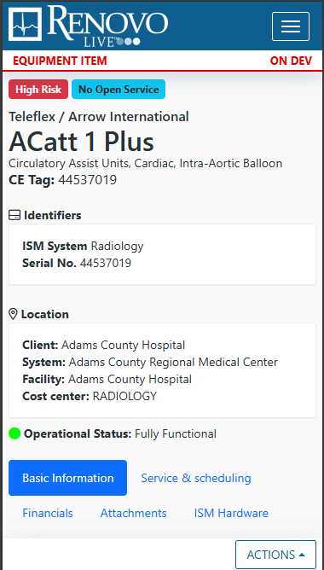
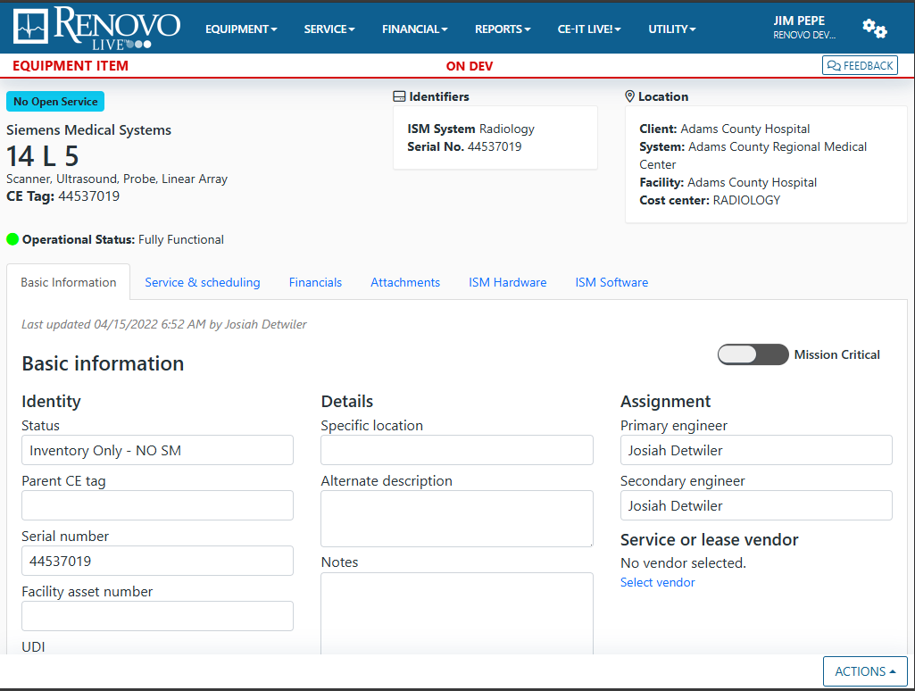
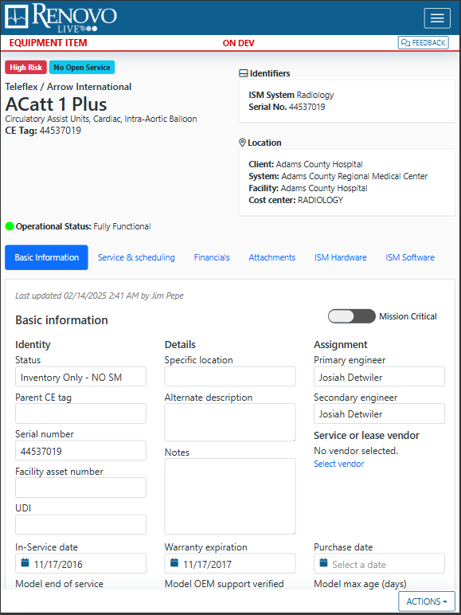
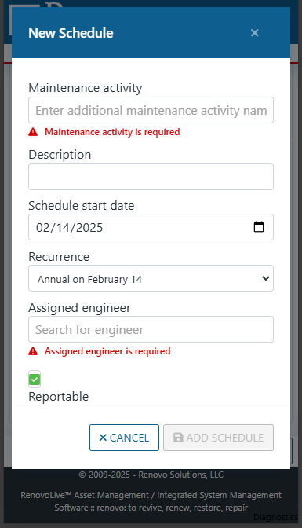
CLIENT STORIES
Renovo Solutions
How can we modernize a platform running on legacy technologies without disrupting its active userbase?
The application was running on outdated technologies which could not support a mobile environment and had data integrity issues due to logic being split between code and stored procedures.
  Modernization Strategy & Build
    Partnered with end users to streamline application flow and consolidate business logic, eliminating conflicting rule sets that caused data integrity issues
    Implemented coarse-grained, reusable code to consolidate and deduplicate business rules
    Converted multiple applications to mobile responsive designs
    Updated multiple versions to bring software versions back up to long term support
    Eliminated legacy code that was causing confusion and extended development times
    Enabled reduced maintenance costs by centralizing logic and componentizing user interface elements
Notes:
Renovo Modernization

Slide 62

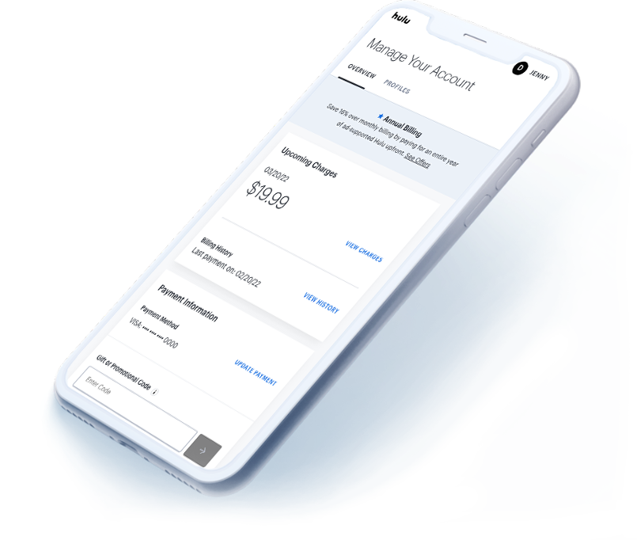
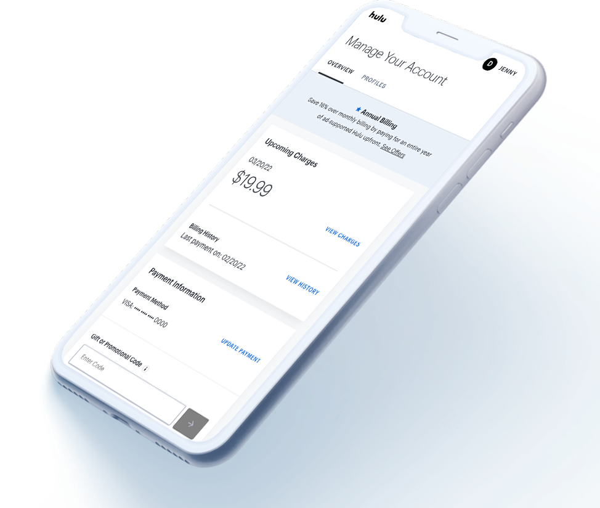
CLIENT STORIES
Hulu
Subscriptions –
Orchestrating multi-platform billing
Hulu’s Billing & Subscriptions team wanted help simplifying the way the multitude of Hulu platforms manage and communicate information about user subscriptions
  Modernization Strategy & Build
    Created a domain model to help developers and stakeholders create a shared understanding and ubiquitous language
    Designed the future state architecture and migration plan to modernize the platform architecture over time
    Update both the technology and the business logic for core APIs
    Centralized the business logic for subscriptions services
    Worked with Hulu teams to instill best practices to support the platform over time
    Improved test coverage
    Revamped onboarding materials to quickly ramp up new team members
    Recommended improvements in communication throughout the billing & subscription group
Notes:
Hulu Subscriptions

Slide 63
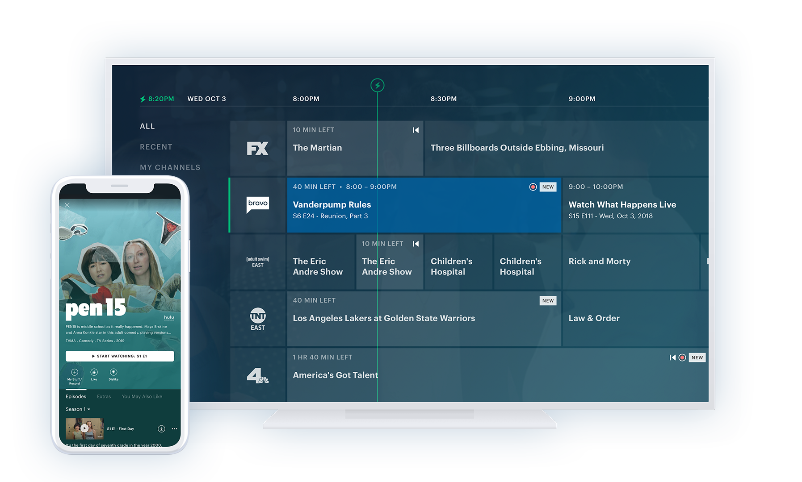
CLIENT STORIES
Hulu
Native iOS &
Apple TV Design & Build
Hulu was approaching the launch of Hulu Live TV and sought out West Monroe to guide their development teams and ensure a timely launch for both their iOS app
and Apple TV app.
  Modernization Strategy & Build
    Our team co-located with the Hulu team in Santa Monica while working with their remote iOS team in Seattle. The two worked together to re-write their iOS app while building out their Apple TV app to support the launch of Hulu Live TV.
    As part of the re-write, both apps were updated to use Swift instead of Objective-C. A reactive framework was introduced to better manage internal app state.
    A significant update was also made to the iOS and tvOS CI pipelines to provide a faster, automated feedback loop for integration tests.
    The team successfully rolled out the app to millions of Apple TV users and was able to make quick and efficient updates.
Notes:
Hulu iOS

Slide 64
CLIENT STORIES
Identity & Access Management Provider
What development opportunities can we capitalize upon to drive efficiency and top-line growth?
Identified 30K annual developer hours in additional capacity to be gained through implementation of tech debt remediation plans
30K
Annual Developer Hours
A leading provider of security and identity and access management (IAM) software was faced with challenges growing the business through product innovation due to challenges with technology debt. West Monroe analyzed the product architecture and source code via automated scans and conducted stakeholder interviews to identify opportunities to increase developer efficiency, reduce code complexity, and increase capacity for innovation. This approach identified critical pain points and actionable remediation activities with quantified value
$5-15M
Identified potential for additional $5-$15M in top-line ARR growth over next 3 years through increased investments in product innovation via increased developer capacity
  Modernization Strategy & Build
    Conducted a full-day workshop to gain a comprehensive understanding of the business's current state and align project scope
    Held over 25 hours of stakeholder interviews to review the code base in detail and identify key areas for improvement
    Analyzed more than 1.2 million lines of code using advanced scans and technology to create detailed dependency maps
    Identified 25 initiatives for addressing technical debt and developed a framework to evaluate the business impact of each initiative
    Created a comprehensive 2-year roadmap for all initiatives, including detailed action plans and analysis of costs, duration, and resource requirements.
  Top-line ARR Growth Potential
I'm very excited about the tech debt [remediation] project coming forward because I do believe there is much value that will be delivered.
— Director, Technical Operations
Notes:
Exostar Tech Debt Remediation

Slide 65
CLIENT STORIES
Construction Company Software Provider
How can we modernize our app and relaunch it in the market with a new user group?
Client was seeking help to modernize their PRO App and relaunch it with a new user group. They also wanted help to evaluate their existing product strategy & roadmap against near-term business objectives.
The project de-risked an initial $5M investment
$5M
  Modernization Strategy & Build
    Our modernization effort prioritized features that reduced maintenance cost, increased usability, and improved end-user productivity. The team took a Product-first mindset and relied on direct input from end users to prioritize epics.
    We rationalized the PRO App to identify modular AI assets that can be re-used and deployed in various parts of the user Journey to improve the overall experience.
    This project de-risked an initial ~$5 million investment and helped identify opportunities that, when implemented, could yield a significant improvement in productivity
Investment
De-risked
The team was able to come up to speed quickly, identify areas of improvement for the solution along with creating thorough documentation to support the application going forward. The team was also able to understand the business quickly and work with end users to identify future needs.
— Chief Information Officer
Notes:
SAFe Built

Slide 66

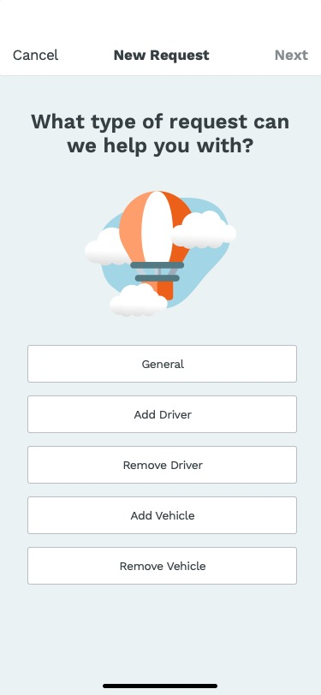
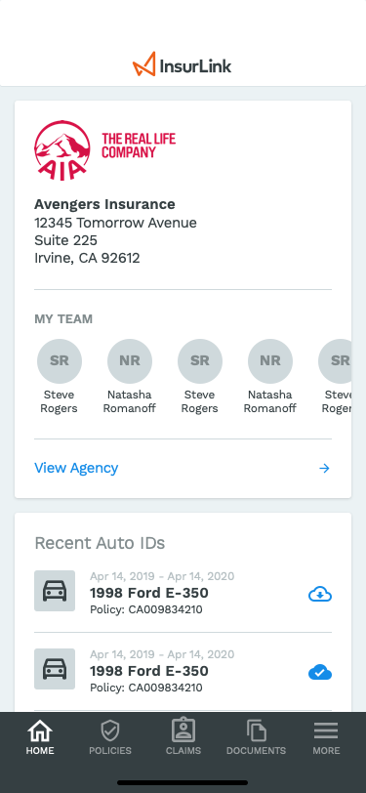
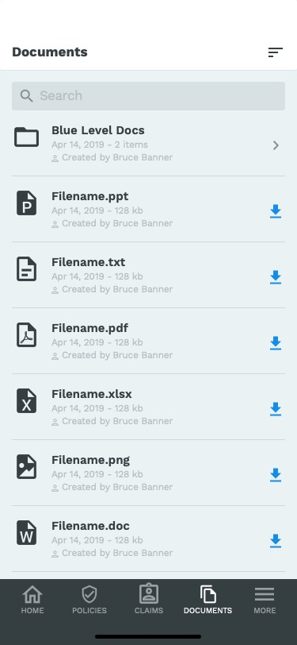
CLIENT STORIES
Insurance Management Software Provider
How can we modernize our codebase and experience to engage our users in a different way? How can insurance agents close/renew policies more quickly?
68%
+5%
Time Savings for Agents
Increased Renewals
Client's end user insurance agents were becoming data entry specialists, uploading documents and data required to provision insurance policies. This was slowing down the time to close or renew policies. Further, the existing product suite failed to engage users, lacking a modern mobile experience that allowed users to easily find content.
  Modernization Strategy & Build
    Conducted persona identification, product discovery, user journey mapping, and prototyping to evaluate and test approaches for simplifying agent interaction, ultimately finding that offloading data entry to customers was preferred and saved agent time
    Modernized client's software by prioritizing key features, streamlining workflows, and integrating advanced technologies, resulting in enhanced performance, user experience, and significant improvements in operational capabilities and customer satisfaction
    Assembled a multi-disciplinary team to build both web and native mobile applications, supporting modern agent/customer interaction and driving efficiency and innovation.
Notes:
Vertafore

Slide 67
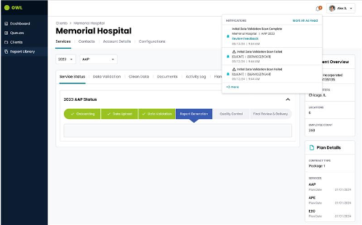
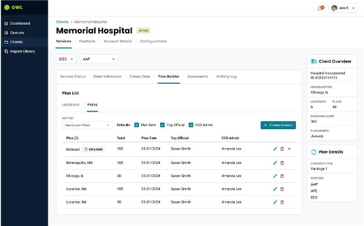
CLIENT STORIES
HR COMPLIANCE Software Provider
How can we prepare for future acquisitive growth and expansion of our enterprise customer base?
65%
Reduction in total report generation duration, saving consultants time
Time Savings for Consultants
Client is a leading provider of affirmative action and compliance solutions which are backed by the advanced capabilities of a proprietary plan management platform. The legacy on-premise platform requires a technical redesign and modernization to address lengthy report processing time, limited integration with third-party systems (e.g., CRM, HRIS, etc.), duplicative functionality and complex user workflows, and security vulnerabilities arising from local desktop database calls.
+$30K
Based on the time savings gained through the changes our team implemented
  Modernization Strategy & Build
    Conducted 35+ interviews with internal users to document existing functionality & pain points
    Assembled an 18-member agile product development team to design and implement the next generation plan management system to accelerate client’s time-to-market
    Developed a roadmap to reduce existing technical debt by rewriting legacy systems using modern, cloud-based technologies (i.e., Microsoft Azure, OpenAI, etc.), including architecture to support future GenAI and Predictive Analytics use case implementation (i.e., predicting billing, cross-sell/upsell, RevOps)
    Designed and built a new platform that will simplify the plan management process, leverage AI/ML to automate highly manual tasks, and provide the foundation for future growth, using modern cloud infrastructure to automate current processes, enable high availability, and drive faster report processing
    Optimized platform costs by leveraging cloud-native technologies (e.g., data storage, analytics, etc.) that only incur costs when in use without impacting application scalability
Avg. Savings per Customer
Notes:
Outsolve

Slide 68
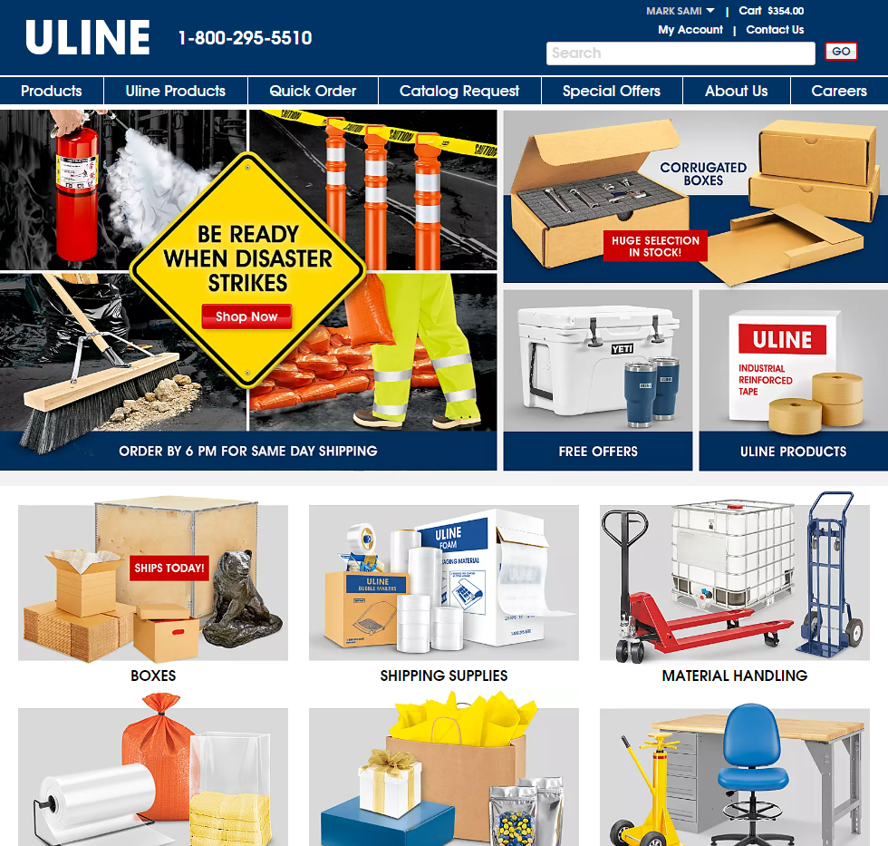
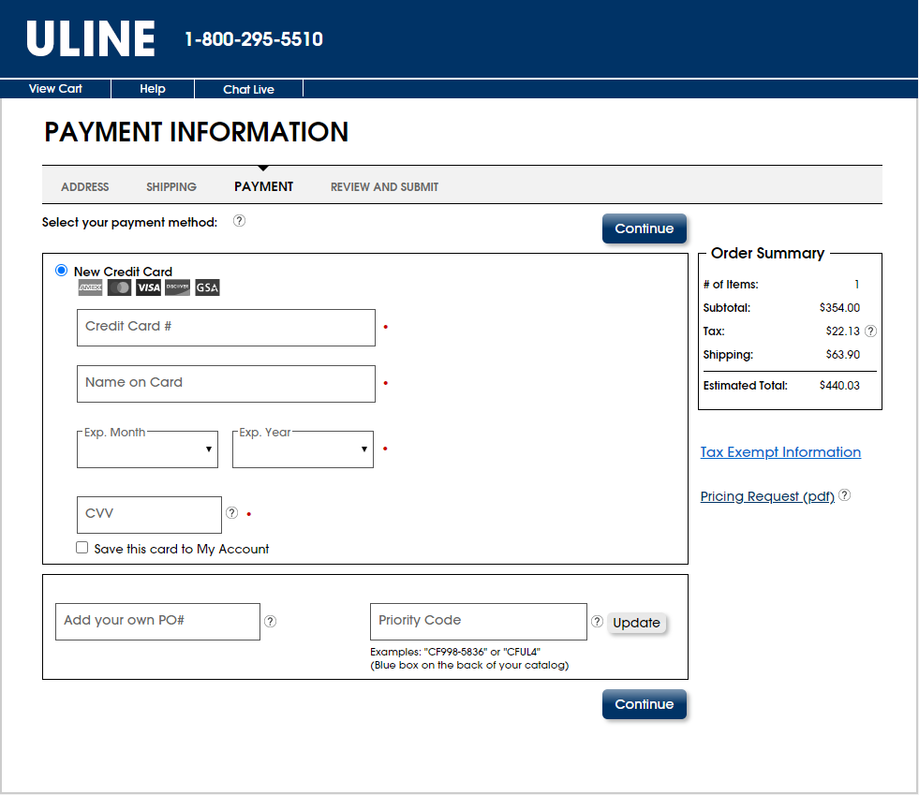
CLIENT STORIES
Large Packaging/Shipping Materials Provider
How can we build a modern platform to replace our legacy apps?
Client doubled in revenue during the pandemic and its systems were struggling to support the rapid growth. They needed a reliable partner that could scale their engineering team to meet deadlines.
  Modernization Strategy & Build
    We worked to identify portions of the client’s modernization roadmap to help accelerate adoption of a modern services architecture to enable more flexible user interfaces across multiple mediums
    We helped architect a custom Java Spring microservices tier and integrate into new and legacy applications with a modern DataStax environment
    West Monroe was able to embed teams alongside Uline’s teams and hit the ground running
    The collective team was able to revamp development processes that ran in a more agile fashion and work across the full spectrum of Uline applications to modernize the underlying data and services to be application agnostic.
Notes:
Uline

Slide 69
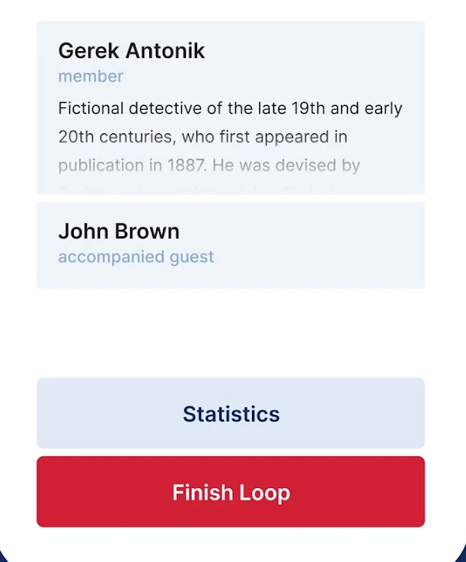
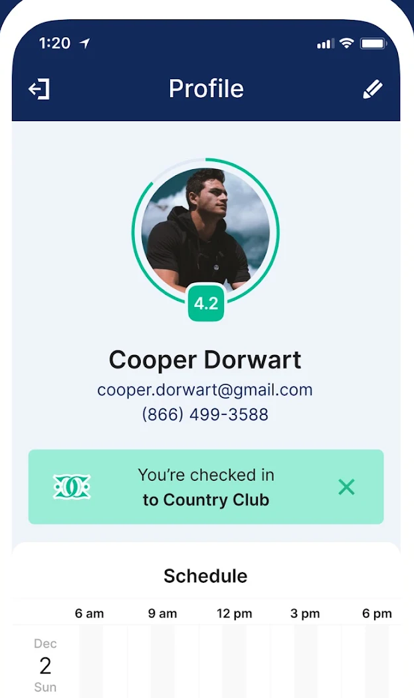
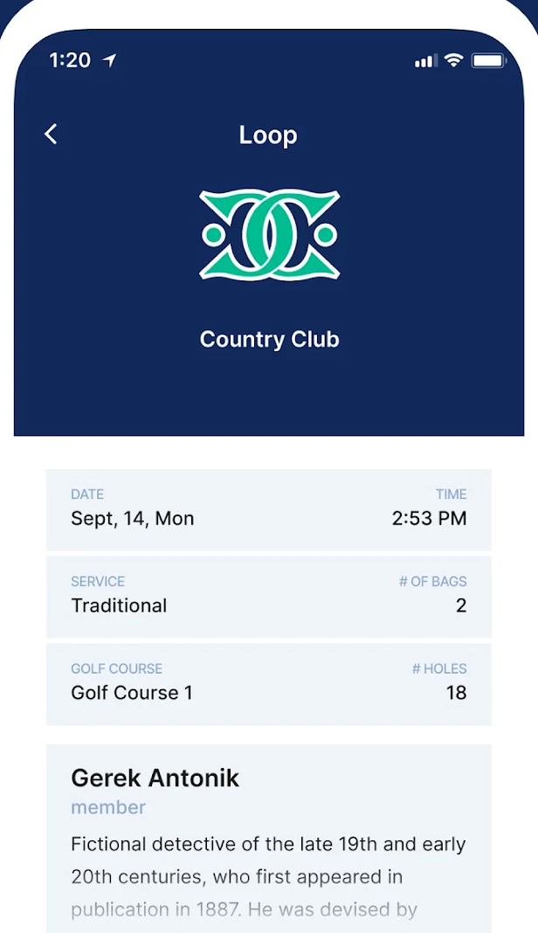
CLIENT STORIES
Golf Club Owner/Operator
How can we fix critical performance and security issues in our critical caddie booking system?
Once complete with our team’s changes, the application yielded 10x performance gains.
10X
Performance Gains
The application was no longer able to scale, and the underlying technology was reaching versions no longer supported making it difficult to grow and maintain.
  Modernization Strategy & Build
    Performed a deep technical analysis of code, databases, and infrastructure
    Established reusable tests and metrics to identify performance bottlenecks and gauge effectiveness of improvements
    Recommended remediations with estimates, then worked with Client to prioritize ~25 technical opportunities based on effort vs. value
    Implemented fixes iteratively over 10 sprints and now providing long-term application support
    Updated multiple versions to bring software versions back up to long term support
    Added CI/CD with gate keeping to ensure standards and best practices were met going forward
    Enabled nearshore team to support and maintain the application at much reduced rates over the long term
Notes:
Troon Golf ClubUp Modernization

Slide 70
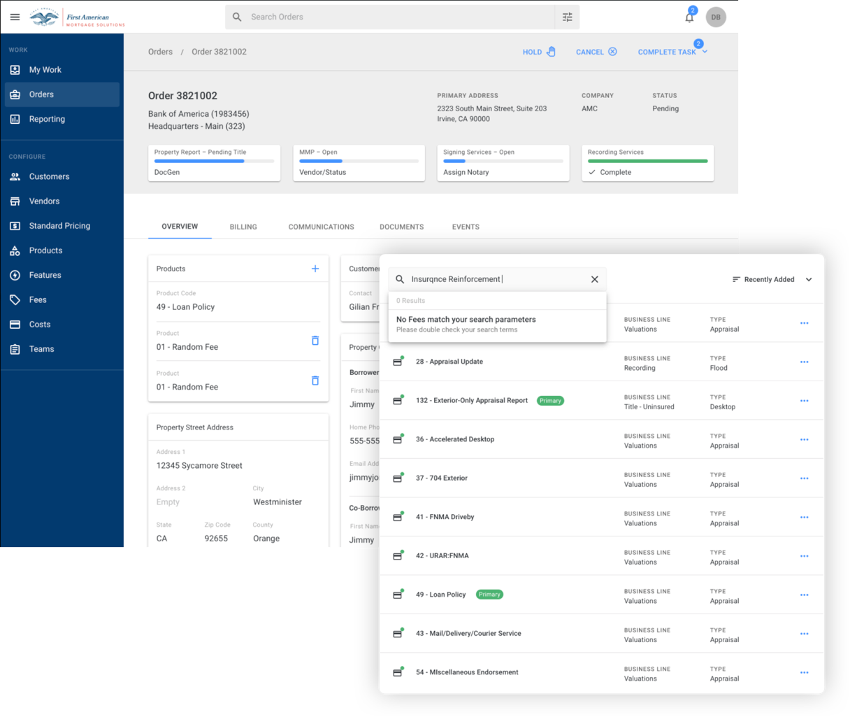
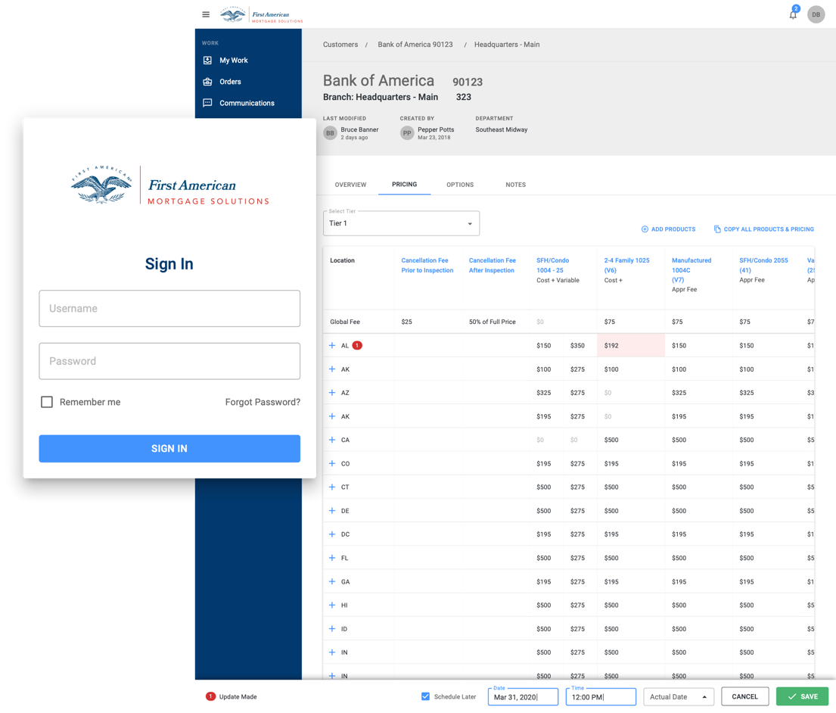
CLIENT STORIES
Large Property & Casualty Insurance Provider
How can we modernize our tech stack and not require our users to multi-task between apps?
Our solution allowed the client to retire five legacy applications, with all workflows being supported through the new platform.
5
Legacy Apps Merged to 1
Client’s application footprint included several legacy, Windows-only, native enterprise applications. These applications required users to multi-task between applications to get their work done. Client brought in West Monroe to re-platform them to a cloud-first tech stack and integrate workflows across applications.
  Modernization Strategy & Build
    Reimagined the customer experience by harnessing technology, data, creativity, and innovation to develop a unified product that meets the client's needs and focuses on enhancing user workflows
    Converted the existing solution to a cloud-based platform and conducted a deep-dive analysis to document and modernize complex workflows, ensuring a seamless transition to modern technology
    Integrated 5 applications into a single cohesive solution by utilizing best practice UX patterns and modern UI, minimizing the need for extensive training on the new application
    Simplified processes for customers by improving access to support and pricing specials, and streamlining the process for completing product orders, thereby transforming the overall business operations
Notes:
First American

Slide 71
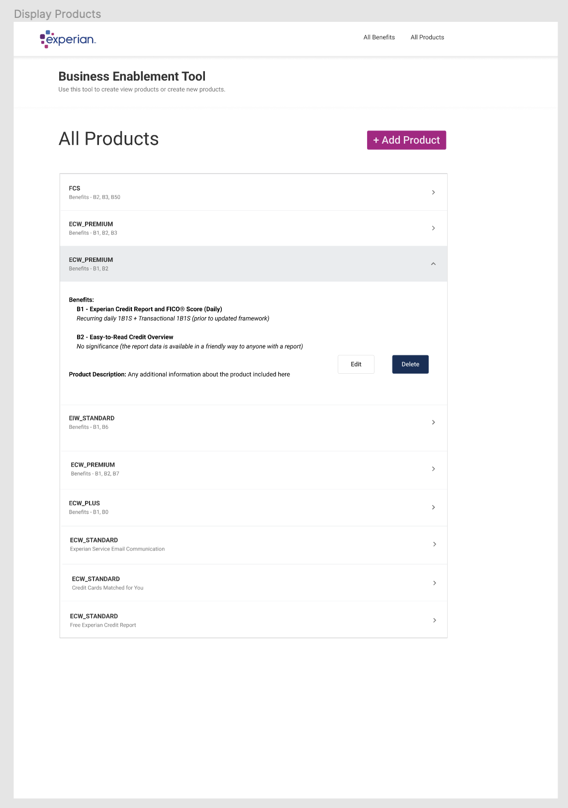
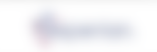
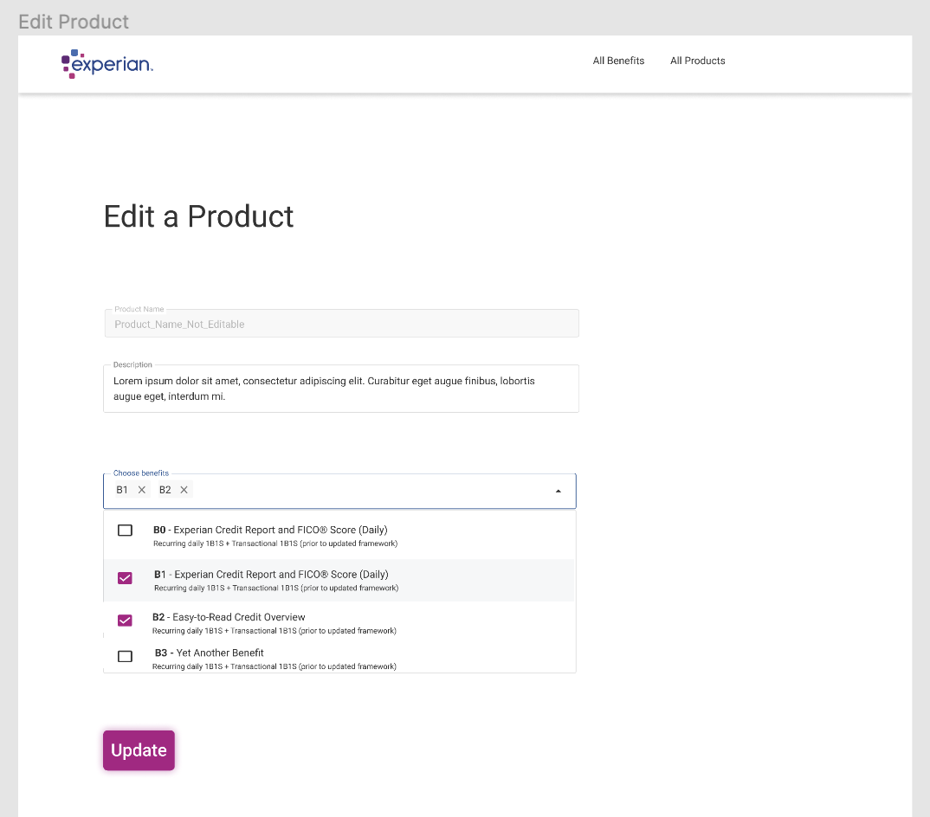
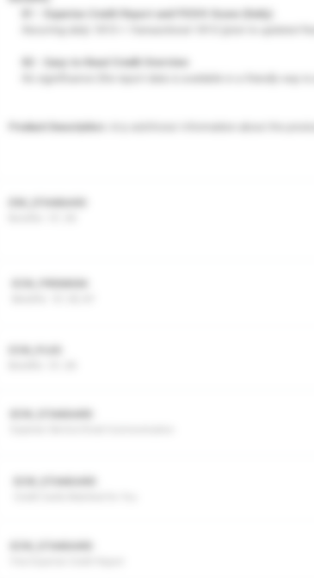
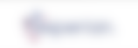

CLIENT STORIES
Large Credit Reporting Agency
How can we modernize our offer publication and update experience?
Reduced the time for publishing and updating offers from 6-8 weeks to under 24 hours, enabling rapid A/B testing and iteration
24hr
Post-Project Offer Publication Time
The client sought to replace their legacy offer management system with a dynamic solution tailored to user demographics. West Monroe embedded a Product Owner to collaborate with the client’s team, designing and building a system that personalizes offers based on user data, significantly improving the offer experience.
  Modernization Strategy & Build
    West Monroe assisted the client in replacing their outdated legacy offer management system with a modern, dynamic solution.
    A Product Owner from West Monroe was embedded within the client's team to facilitate seamless collaboration and integration.
    Together, they designed and developed a sophisticated system that personalizes offers by leveraging detailed user demographic data.
    This tailored approach significantly enhanced the offer experience, boosting both accuracy and sales effectiveness for the client.
Notes:
Outsolve

Slide 72
CLIENT STORIES
Community bank
How can we better position our technology for sustainability and efficiency?
Identified redundant apps, unlocking $2.77M in savings (15% of tech spend), enabling Client to simplify its tech landscape
15%
Identified IT Cost Reductions
Client, a Community Bank in Kansas, faced shifts in their business model due to changes in the Financial Services Industry and interest rates. They engaged West Monroe to assess their technology landscape, identifying risks, scalability issues, and improvement opportunities. West Monroe also rationalized applications in Accounting and Compliance and developed a future state architecture and roadmap as part of the Innovation Strategy & Roadmap initiative.
Recommended RPA tools and self-service reporting to streamline workflows, resulting in retirement of 6 apps and $350K in yearly savings
6
  Modernization Strategy & Build
    Established a maturity framework to assess the client's current state across digital capabilities including governance, strategy, SDLC, data engineering, security, and infrastructure
    Conducted a comprehensive review of the Bank's technology landscape, including in-depth interviews with key stakeholders to understand application relevance to business operations
    Performed an IT spend and resource benchmark and identified recommendations to address risks, scalability issues, and gaps in the technology portfolio, processes, and organization
    Developed a roadmap with key dependencies, milestones, and high-level cost estimates, along with future state solution architecture for Accounting and Compliance processes
    Recommended initiatives that Increase focus on data & analytics capabilities to enable business users to efficiently access data to enable data-driven decision making, enhance IT governance and organization structure through implementing formal processes, and create and deploy technology solutions based on consistent guiding principles and architecture patterns
    Provided advisory support for the Tech Steering Committee throughout the project duration
  Mid-tier Apps Retired
Notes:
NASB Application Rationalization

Slide 73
CLIENT STORIES
Workplace Safety & Compliance Provider
How can we expand our occupational health offering while modernizing our architecture?
The features span ordering/fulfillment processes and enabling functions like client settings across multiple applications and tech stacks
50+
Features Identified for Modernization
Client specializes in drug testing, employee background and occupational health screening, transportation compliance, and substance abuse training. Their dated monolithic architecture results in large, risky releases and presents challenges in upgrading specific domains.
  Modernization Strategy & Build
    Performed an initial architecture deep dive phase to identify pain points and formulate an approach ahead of the build phase
    Streamlined the implementation approach by instituting a more Agile design and development process than that of other vendors, significantly lowering the time to produce working, high-quality code
    Split the occupational health domain apart from the on-prem monolithic back-end by creating a new .NET Core microservice and SQL database hosted in Azure
    Currently revamping their current internal-facing and client-facing experiences, replacing ASP.NET web pages with React in the process
    Will leverage Azure Data Factory to perform a one-time data migration to retire occupational health data in the legacy on-prem SQL Server database and have the Azure SQL database become the source of truth, updating downstream systems to pull from the new microservice
The WM team has provided great value in the organization and knowledge they bring to the table.
— Sr. Director, Product Management
The West Monroe resources that have been assigned to this engagement have been outstanding.
— Director, Software Engineering
Notes:
DISA

Slide 74
One consequential application or process
NOMINATION PROMPT
QUALIFICATION CONDITIONS
1
A catalyst creates a decision window within 12 to 24 months.
Where does one consequential application or process constrain growth, operations, risk, cost, customer experience, or AI readiness?
2
Important rules, dependencies, integrations, exceptions, or workarounds are poorly understood.
3
More than one modernization path is genuinely open.
4
Business and technology owners can provide source, artifact, operator, and expert access.
MODERNIZATION OPTIONS SPRINT RETURNS
Subject to delivery and commercial validation
1
Agreed modernization thesis and scope
2
Source-backed current-state and uncertainty baseline
Bring a real decision window and enough access to test the question.
3
Connected view of the application and business process
4
Disposition and target-direction comparison
5
First-wave, cutover, measurement, and business-case outline
Bring one account, one application, and one business process to the modernization and Evolve team for qualification.
© 2026 West Monroe Partners | Reproduction and/or distribution without West Monroe Partners’ prior consent is prohibited.
51
Notes:
The sprint establishes a baseline so AI-enabled gains can be measured rather than promised.
Some nominations will lead to retirement, packaged replacement, or a non-Evolve approach.
That is a successful decision if it is well supported.
Duration, price, owners, routing, and entry criteria still require confirmation before release.

Slide 76
INTERNAL PICK-DECK GUIDE
SECTION PLACEHOLDERS
Off-the-Shelf Modernization Offerings
01
Offer catalog (TBD)
02
Buyer + catalyst fit
Placeholder for a modular offer catalog that makes it easier to match common buyer needs to a defined scope, timeline, and outcome.
03
Scope + deliverables
04
Path to next phase
PLACEHOLDER SECTION — Add approved offer names, owners, timing, commercial model, entry criteria, and proof.
© 2026 West Monroe Partners | Reproduction and/or distribution without West Monroe Partners’ prior consent is prohibited.
Notes:
Source deck: Software Modernization Walking Deck_04132026.pptx.
Insert source slides 9 through 11, 13 through 14, and 15 through 31 unchanged after this divider.
Omit source slide 12 because it is the old contact call to action.
Preserve source order, formatting, metrics, client descriptors, caveats, and notes.
The source is internal and verify-before-external-reuse.
Some outcomes may be modeled or identified rather than realized, and notes may contain names not visible on slides.
Transition: After a selected proof example, bring the audience back to one specific account action.

Slide 77
Intellio Evolve capability development and 9 month access/support

Slide 78
ASSOCIATED MATERIALS | ENGAGEMENT MODEL
RESTRICTED CLIENT WORKING DRAFT
A three-month Intellio Evolve Code Insights & Enablement Pod builds the knowledge capture capability, followed by sustainment and transition
MONTHS 1–3
MONTHS 4–12
Intellio Evolve Code Insights & Enablement
Intellio Evolve Sustainment & Transition
Build Associated Materials’ internal capacity to use Intellio Evolve and self-lead its knowledge capture of legacy portfolio apps
Advisory support on Associated Material’s continued knowledge capture including Evolve product support and usage guidance
THE TEAM
THE TEAM
INCLUDED FOCUS
Technical Lead
Full-Time
Technical Lead
8 hrs/week
Office hours and light advisory and training support
Intellio Evolve guidance and coaching
Product enhancements and upgrades as capacity allows
Senior Engineer (Nearshore)
Full-Time
Senior Engineer (Nearshore)
8 hrs/week
Oversight / SME
As needed
Oversight / SME
As needed
FIXED PRICE FOR ALL 3 MONTHS: $235,000
Fee: To be determined once first phase of Intellio Evolve Code Insights & Enablement is complete
We can also help build your internal modernization capability while adding capacity and expertise to drive concrete modernization initiatives in future.
Modernization Discovery (Optional if needed in future)
MONTHLY CAPACITY RATE
Modernization Execution (Optional if needed in future)
MONTHLY CAPACITY RATE
Analyze the legacy application portfolio, conduct discovery, build modernization backlog, and define a full-scale modernization path across architecture, process, technology, and delivery.
Provide a dedicated pod to write code, test, and validate quality with stakeholders executing modernization end to end.
Fees are intentionally excluded. Evolve access, cloud and model costs, sustainment capacity, discovery, and execution remain separable contract components.
Notes:
Purpose: Show the default 12-month path and two optional expansion paths without implying that the base pod performs full discovery or modernization execution.
Sources: Plaud recording ac1680f492e61866bac7014b78fb3f54, especially 11:45–20:59; user-provided staffing screenshot /Users/rscott/Desktop/Screenshot 2026-09-16 at 3.55.07 PM.png; 2026-09-16-associated-materials-engagement-model-slide.md.
Commercial guardrails: Do not describe the base model as 24x7 support, managed operations, unlimited rescanning, unlimited application onboarding, or guaranteed response times. The client remains responsible for access, source and build artifacts, SME participation, acceptance, production approval, and deployment unless scoped otherwise. The Senior Architect allocation in sustainment is held to 0.5 day per week as requested.
Confidentiality: Restricted, client-derived material. Account-context-only. Sanitize and approve before reuse.

Slide 79

INTELLIO EVOLVE | INTELLIGENCE TOOLS COMPARISON
Code Intelligence tools create strong software intelligence.
Intellio Evolve turns it into business-aligned insights and modernization action.
RELATIVE DEPTH
Baseline
Enhanced
Comprehensive
BUYER NEED
CODE INTELLIGENCE
EVOLVE
CAST and representative alternatives
Intelligence + expert practitioner
Portfolio & cloud readiness
Portfolio assessment, cloud readiness
and rationalization
Business-prioritized portfolio plan
Architecture, dependencies & data
Semantic architecture, dependencies
and data flows
Expert-validated architecture
and change strategy
Functional understanding & specs
AI summaries, business rules
and technical specifications
SME-validated functional model
Business value alignment
Business context, technical scoring
and decision evidence
Value thesis, priorities
and decision rights
Target architecture & roadmap
Roadmaps, blockers and
target-state inputs
Approved target state
and sequenced roadmap
Execution support & governance
Services, partner ecosystems
and delivery handoffs
Accountable delivery, governance
and capability transfer
THE INTELLIO ADVANTAGE
Intelligence tools help you understand the estate.
Intellio Evolve combines software intelligence with human-augmented practitioner expertise to determine what to change—and carry those decisions into execution.
THE BUYER GAP
Intelligence tools produce substantial portfolio and application intelligence. The remaining challenge is converting that intelligence into business-approved architecture, scope, sequencing, and implemented change.
Dots indicate relative comparative strength—not complete capability. The intelligence-tools column reflects representative software capabilities; Evolve reflects intelligence combined with practitioner-led guidance and execution support.
Notes:
Purpose: Make the subset relationship visible. CAST Highlight is strongest at portfolio assessment; CAST Imaging is strongest at deep application intelligence. Intellio Evolve adds source-backed modernization understanding and decision-ready artifacts. The combined Evolve and West Monroe offer closes the value gap by adding expert architectural opinion, business-value alignment, bespoke gap analysis, approved scope and sequencing, and accountable support through execution. The intended buyer takeaway is: CAST gives me strong analysis assets, but Evolve and West Monroe tell me what to do with them and help me execute.
Sources: 02-evolve-vs-cast.md; 2026-09-14-cast-software-and-cast-ai-competitive-research.md; 2026-09-16-blitzy-cast-intellio-evolve-competitive-brief.md; current-product-capabilities.md.
Claim guardrails: This compares CAST product outputs with the combined Evolve and West Monroe offer. CAST has services and partners, so do not claim CAST cannot support delivery. CAST Imaging includes AI summaries and business-rule extraction. Do not claim portfolio rationalization parity, broader technical mapping, or autonomous modernization for Evolve. West Monroe implementation remains separately scoped.

Slide 80
Standard mod rationalization

Slide 81
RATIONALIZATION & MODERNIZATION STRATEGY
Rationalization connects application decisions to reimagined business workflows, a modernization roadmap, and conceptual architecture
A focused ~4–8 week effort reconstructs how work gets done today, reimagines the future-state workflow, and aligns application dispositions to value, health, risk, and enterprise architecture
OBJECTIVES
OUTPUTS
01
Prioritize the application portfolio
Decision-ready rationalization outputs
Confirm in-scope applications and understand costs, roadmaps, ownership, and planned changes
Assess value, health, and risk
Portfolio fact base and current-state workflow map
02
Assess business value, technical health, risk, dependencies, and architecture fit through owner interviews and technology analysis
Business value, technical health, and risk profiles
03
Reconstruct current-state business processes
Map workflows, handoffs, pain points, exceptions, and application touchpoints with business and application owners
Application disposition register
04
Define application dispositions
Reimagined workflow and modernization roadmap
Create and socialize initial dispositions; identify the applications best suited for modernization
05
Reimagine future-state business workflows
Conceptual future-state architecture
Design workflows tailored to how the business operates, then translate them into modernization targets, architecture, interim states, and a sequenced roadmap
Rationalization defines what to modernize and how the business should work in the future
EXECUTIVE DECISION
The outputs become the starting context, priorities, process vision, and guardrails for modernization execution
Approve strategy • Refine scope • Begin execution
© 2026 West Monroe Partners | Reproduction and/or distribution without West Monroe Partners’ prior consent is prohibited
4
Notes:
Working draft based on the Patterson Eaglesoft pursuit brief, the West Monroe modernization lifecycle working model, Intellio Evolve strategy material, and the user-provided AI-native PDLC working deck. The 4–8 week range and high-level 7R framing are planning assumptions, not commercial commitments.

Slide 82
RATIONALIZATION ACTIVITY PLAN
A 6–8 week rationalization engagement builds evidence, validates dispositions, and converts priorities into an actionable modernization strategy
Core assessment: Weeks 1–4 Strategy deepening: Weeks 5–8 as needed
ACTIVITY
CORE ASSESSMENT
STRATEGY DEEPENING
PRIMARY OUTPUT
Workstream activity
W1
W2
W3
W4
W5
W6
W7
W8
What the work produces
Confirm scope, portfolio, and decision criteria
Scope and decision criteria
Collect application costs, roadmaps, ownership, and planned changes
Application portfolio fact base
Assess business value and strategic fit
Business value profile
Assess technical health, risk, and dependencies
Technical health and risk profile
Interview application owners and validate pain points
Validated owner insights
Define and socialize initial application dispositions
Application disposition register
Align dispositions to enterprise architecture direction
Architecture principles and constraints
Prioritize modernization targets and waves
Prioritized modernization roadmap
Define future-state architecture and interim phases
Conceptual future-state architecture
Executive review and modernization strategy decision
Approve, refine, or begin execution
Rationalization outputs carry directly into modernization execution as prioritized targets, architecture guardrails, sequencing, and decision criteria
© 2026 West Monroe Partners | Reproduction and/or distribution without West Monroe Partners’ prior consent is prohibited
5
Notes:
The activity plan intentionally shows overlap. The core path can close in approximately four weeks, while deeper slice validation, dependency analysis, or planning detail can extend the work through Week 8. The register is an initiative and epic view for program definition, not a detailed implementation backlog.

Slide 83
INTERNAL PICK-DECK GUIDE
SUGGESTED FLOW
Sample First-Call Proposal
01
Economics shift
02
Why modernization now
Use this five-slide path as a starting point, then tailor the proof and depth to the buyer's catalyst and role.
03
West Monroe perspective
04
Lifecycle + relevant proof
PLACEHOLDER SECTION — Recommended path: opener, economics, perspective, lifecycle, and one relevant case study or offer.
© 2026 West Monroe Partners | Reproduction and/or distribution without West Monroe Partners’ prior consent is prohibited.
Notes:
Source deck: Software Modernization Walking Deck_04132026.pptx.
Insert source slides 9 through 11, 13 through 14, and 15 through 31 unchanged after this divider.
Omit source slide 12 because it is the old contact call to action.
Preserve source order, formatting, metrics, client descriptors, caveats, and notes.
The source is internal and verify-before-external-reuse.
Some outcomes may be modeled or identified rather than realized, and notes may contain names not visible on slides.
Transition: After a selected proof example, bring the audience back to one specific account action.

